Slide 1
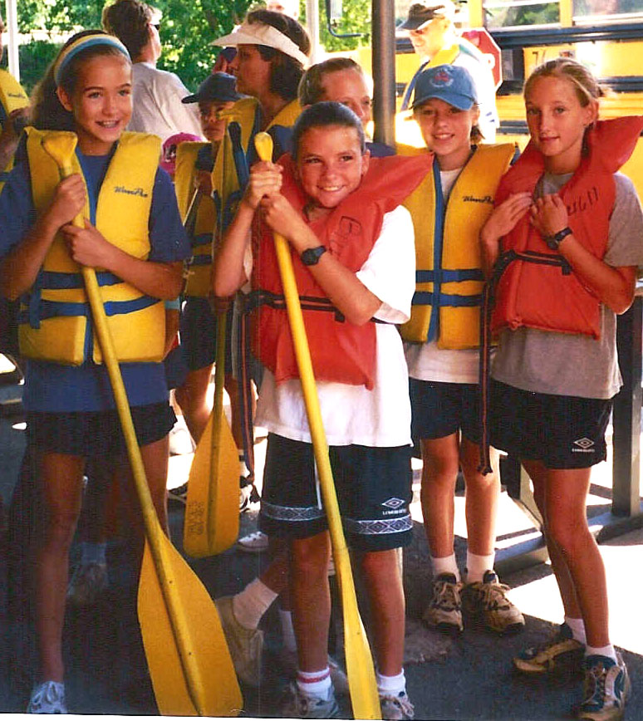
AHG Health and Safety Guidelines
Notes:
The adult leaders and members of each American Heritage Girls Troop are accountable for administering American Heritage Girls programming in a safe and responsible way. Knowledge and adherence to AHG guidelines will help to ensure the health, safety and well-being of every girl and adult involved. In addition, your compliance to AHG Health and Safety Standards is necessary in order for each AHG member to be covered under AHG’s Group Insurance. Management of risk is necessary to the well being of our precious girl members as well as to the continuance of the AHG ministry.

Slide 2
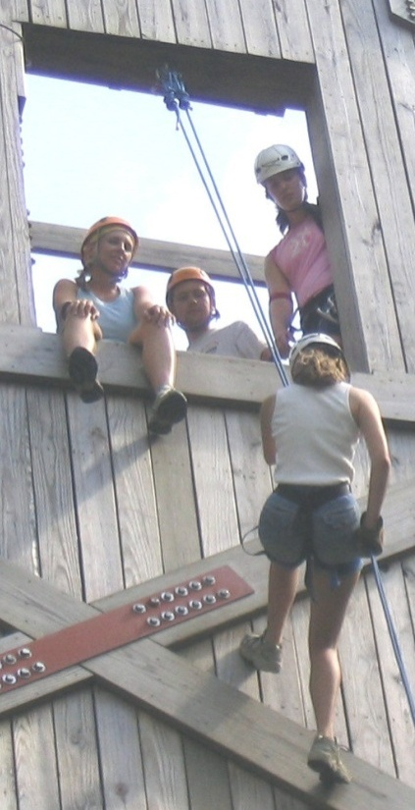
Health & Safety Standards
Qualified Leaders/Volunteers as health and safety role models
Planning
Communication
Safe area
Buddy system
Awareness of physical fitness and skill level of participants
Safe, maintained equipment
Weather check
First-aid and CPR resources
Discipline, control and respect
Notes:
AHG provides Health and Safety Standards that are located in the appendix of the Unit Leader and Troop Coordinator Handbooks. They are also available as a download on the Leader portal of the AHG website. It is most important all adult volunteers working with the girls have a working knowledge of these guidelines and refer to them often.
Health and Safety Standards include the following concepts:
Establishing Qualified Leaders/Volunteers who are willing to be health and safety role models.
The important of planning
The need for a communication plan
The need to establish a safe area in time of peril
The importance of the Buddy system
Awareness of physical fitness and skill level of each participant
The need for safe, maintained equipment
The need for weather awareness
The identification of First-aid and CPR resources
The need for discipline, control and respect of all participants

Slide 3
Role of Planning
Ensures an effective, safe & enjoyable experience
Runs smoothly, reduces risk & matches girls needs and desires
More enjoyable for adult volunteers because of the knowledge of expectations & schedule before activity begins
Notes:
Planning is perhaps the most crucial part in conducting an effective, safe and enjoyable activity for girls. Proper planning allows activities to run with ease, risk to be reduced and an effective matching of girls needs and desires. Planning can seem an overwhelming task, but work put in during the planning stage comes back ten fold as leaders are able to also enjoy well-planned activities.

Slide 4
Safety Awareness
Unit Leaders are expected to:
Follow all AHG Health & Safety Guidelines for all program activities.
Choose appropriate activities based on girls’ ages, abilities and limitations.
Use sound judgment to take necessary precautions to avoid accidents.
Work in partnership with girls in safety planning and implementation.
Promote the concept of safety consciousness at all times, in all places.
Notes:
To safeguard health and instill a sense of safety, Unit Leaders will agree to provide the following:
Follow all AHG Health & Safety Guidelines for all program activities.
Choose appropriate activities based on girls ages, abilities and limitations.
Use sound judgment to take necessary precautions to avoid accidents.
Work in partnership with girls in safety planning and implementation.
Promote the concept of safety consciousness at all times, in all places.

Slide 5
Safety Awareness
Girl Members are expected to:
Work in partnership with the leader in planning for safety.
Listen to and follow instructions and suggestions.
Make safe choices.
Learn and practice safety skills.
Evaluate situations where a safety risk is involved.
Suggest additional safety guidelines and precautions.
Notes:
In doing her part to protect her own and others’ well being through safe, healthy attitudes and practices, each girl member should:
Work in partnership with the leader in planning for safety.
Listen to and follow instructions and suggestions.
Make safe choices
Learn and practice safety skills.
Evaluate situations where a safety risk is involved.
Suggest additional safety guidelines and precautions.

Slide 6
Overview of
Health and Safety
Quality Supervision
Two Deep Leadership
Appropriate Girl/Leader Ratios
Above Average Knowledge & Skill for Specialized Activities
Notes:
Quality supervision is necessary to ensure the health and safety of all members. Supervision must be at least two-deep, allowing for added supervision, ensuring no one-on-one contact between adult and child. There should always be a minimum of two registered adults (with at least one having completed AHG’s Basic Training courses) for each activity.
Appropriate Girl/Leader ratios must be maintained all times.
All adult volunteers must be at least 21 years of age.
Young women, 18-21 years of age, may assist with an AHG Troop, but may not be counted in the Girl/Leader ratios. nor may they serve as a driver on field trips.
Supervision for specialized activities should include an above average level of knowledge and understanding of skills and equipment utilized.

Slide 7
Overview of
Health and Safety
Leadership have a working knowledge of the AHG Health & Safety Standards
No Physical Punishment Allowed
Understanding & adherence to the AHG Child Abuse Prevention Policy
1 CPR/First Aid trained adult per Level during all AHG Activities
Notes:
All adults in supervisory positions should have a working knowledge of the Health and Safety Standards.
Under no circumstance is physical punishment permitted.
The AHG Child Abuse Prevention Policy must be understood by all volunteers and adhered to at all times.
There must be at least one CPR/First Aid trained adult per level during all AHG activities.

Slide 8
Girl / Leader Ratios
Pathfinder: 6 girls per 1 registered Leader
Tenderheart: 6 girls per 1 registered Leader
Explorer: 8 girls per 1 registered Leader
Pioneer: 10 girls per 1 registered Leader
Patriot: 12 girls per 1 registered Leader
Notes:
Review the Girl/Leader Ratios by Level.
Girl/Leader Ratios must be maintained at all times. Remember two deep leadership is essential despite ratio numbers. As an example, one registered leader cannot take six Pathfinders on a field trip or conduct a meeting. She must have a second adult present to maintain the “two deep leadership” safety standard.

Slide 9
Troop Meeting Standards
Meeting Place should be accessible to all
Buildings should be safe, secure, clean, properly ventilated, heated, well-lit, hazard free
Adequate space for planned activities
Leaders should arrive early to unlock doors (no girls waiting outside)
First-Aid Kit at all meetings
One First-Aid and CPR Certified adult per Level must be present
Girl and Adult Health & Medical History Forms accessible at Troop meeting site
Notes:
It is most important that the following standards be met at your Troop meeting site. Standards include:
Meeting Place should be accessible to all, taking into consideration accommodating for girls with special needs
Buildings should be safe, secure, clean, properly ventilated, heated, well-lit, hazard free
Adequate space for planned activities
Leaders should arrive early to unlock doors (no girls waiting out side)
One First-Aid and CPR Certified adult per Level must be present
Girl and Adult Health & Medical History Forms accessible at Troop meeting site
First-Aid Kit at all meetings.

Slide 10
Release of Members
Parent sign in/out sheet
Supervised sign in/out area
Review release procedure with parents
No child should be released to anyone without permission from parent/guardian
Non-custodial parents/others must show a photo ID and sign a sign-out sheet
Troop procedure for failure to pick up
Notes:
All Troops should have a release procedure in place for Troop meetings and activities. This should be shared with all adult volunteers and families of the Troop on an annual basis and available in the Troop Policy Manual. Detailed information regarding release of members can be found on pg. 101 of Unit Leader Handbook and 98 of Troop Coordinator Handbook. Remember to assign an adult volunteer to this important job at the end of each meeting.
( pop up add pg . 98 in Troop Coordinator handbook)

Slide 11
Discipline
Discipline is important in following rules and ensuring a safe environment.
Administered according to AHG values.
All discipline should remain constructive and positive.
Under NO circumstances is physical punishment to be used.
Discipline should occur in the presence of an adult witness.
Each Troop should develop a Troop Discipline Policy.
Notes:
Discipline is important in following rules and ensuring a safe environment. Discipline should be administered according to American Heritage Girls values. Under NO circumstances is physical punishment to be used. All verbal comments should remain constructive and positive. Discipline should occur in the presence of an adult witness. Each Troop must have a Troop Discipline Policy, contained in the Troop Policy Manual, and have it signed by both parents and child.

Slide 12
Troop Emergency Preparedness
Emergency Plans should be specific to each activity
Emergency procedure plan included in the Troop Trip Packet
Reporting of an Emergency – within 24 hours to AHG, Inc. Office
Media inquiries directed to AHG, Inc. Office
Notes:
Advance emergency plans must be made to help cope with the unexpected. All Adult Volunteers and girl members should have a basic knowledge of emergency procedures at the Troop meeting place and for any activity sites. (i.e. camping, etc.) Often times facilities will have emergency plans for their sites. Ask about it when reserving a facility. Common questions include:
-where to go in the case of a tornado?
where the nearest medical facility is located?
what are the “lock down” plans for intruders?
where is the closest telephone?
the phone number of the ranger or person in charge of the facility.
Emergency Plans should be specific to each activity (specifics for a plan can be found on pg. 102 of UL Handbook & pg. 99 of Coordinator Handbook)
Emergency procedure plan should be included in the Troop Trip Packet when activities are outside of the regular meeting place.
Reporting of an Emergency – within 24 hours to AHG, Inc. Office – complete the Incident Report Form (available on the Leader portal area of AHG website)
All Media inquiries regarding an incident occurring during an AHG event, must be directed to AHG, Inc. Office.
(add page pop up pg . 99 in Troop Coordinator handbook)

Slide 13
Security
Buddy System
Head Counts
Lost Plan
Telephone Location
Unfamiliar faces
Restrooms
Release Procedures
Notes:
The buddy system can be an efficient way of keeping count of large groups. It is also a good system to have in place during outdoors activities (i.e. bathroom breaks, etc.)
Head counts are crucial when working with large groups. Assigning adult volunteers to manage smaller groups can help in a large group activity.
Girls should be aware of what to do if they get lost. A quality whistle can help save a life. Locate an “safe” place and notify the girls of the location.
Know where the nearest telephone is located and notify your girls of its location. Don’t rely just on someone’s cell phone, especially if there is no service in a remote area or even in some enclosed buildings.
During an event or camping trip, it is the responsibility of adult leaders to confront unfamiliar faces.
Girls should not go to into public restrooms alone.
The “release of Girl members” policy should be strictly followed.

Slide 14
First-Aid
All Unit Leaders are urged to become CPR and First-Aid certified
Designate an Adult Volunteer as the H&S lead for each AHG activity
A First-Aid kit must be present at all AHG outings, camps, and meetings
Sample First Aid Kit
Notes:
All Unit Leaders are strongly urged to become CPR and First-Aide certified. All Troops are required to have at least one CPR & First Aid certified Unit Leader per level present at each meeting and activity with these certifications.
Troops are encouraged to designate one Adult Volunteer as the Health and Safety lead for each AHG activity. This individual will act as the main first-aider and should also be in charge of the security and administration of medications. A registered Adult Volunteer with a medical background (such as a MD or RN) is ideal for this position. Remember to have the “lead” wear a distinguishing mark & know their location at all times. (walkie-talkies are invaluable)
A first-aid kit must be present at all American Heritage Girls outings, camps and meetings. A suggested listing of items for a basic first-aid kit used at meetings and day outings can be found on pg. 103 in Unit Leader Handbook or pg. 100 in Coordinator Handbook)
(add page pop up pg . 100 in Troop Coordinator handbook)

Slide 15

Medication Policies
Medical information is confidential.
Designate a Troop Health & Safety Lead.
No girl may self medicate and keep over the counter medications or prescriptions on their person.
AHG policy does not mandate a Unit Leader dispense medication.
Administration of medications: follow instruction on Parent Permission Form & Request for Medication Administration.
Notes:
As a reminder, all medical information should be considered confidential and shared only with those that are responsible for the health care of the Troop. Medication logs, health forms and incident reports should be kept in a locked area when not being used.
General guidelines include:
Designate a Troop Health & Safety Lead
No girl may self medicate or keep over the counter medications or prescriptions on her person. (exceptions are inhalers & epi pens)
AHG policy does not mandate a Unit Leader dispense medication. Troop volunteers should discuss alternative options if an adult volunteer is not comfortable with dispensing medications. An option may be that a parent will need to attend and administer the medications.
Instructions should be followed on the Parent Permission Form & Request for Medication Administration when administering medications
Additional information about medication policy and procedures can be found on pg. 105 of the Unit Leader Handbook and pg. 102 of the Coordinator Handbook.
(add page pop up pg . 102 in Troop Coordinator handbook)

Slide 16
Transportation Policies
Troop Transport Forms
Unacceptable Moving Violations
Girl/Volunteer ratios & two deep leadership present during transportation
Notes:
The transportation of girls members for Troop activities must following AHG guidelines, which can be found on pg. 107 in the Unit Leader Handbook and pg. 104 of the Troop Coordinator Handbook.
Transportation highlights include:
All potential drivers for Troop activities must complete the Troop Transport Form, verifying auto insurance, seatbelts and driver’s license. This form must be on file with the Troop Leader and updated on a yearly basis.
If an adult driver has any of the following violations in the last three years, they may not transport girl or adult members on any Troop activity:
Driving under the influence
Reckless operation
Leaving the scene of an accident
Two or more moving violations within the last 12 months
Three or more moving violations within the last 3 years.
Appropriate Girl/Volunteer ratios and “two deep leadership” should be present during transportation. Supervision during transport should include one registered Adult Volunteer and one other adult. This is vital if a girl has an emergency in the car and to safeguard the interests of both volunteers.
(add page pop up pg . 104 in Troop Coordinator handbook)

Slide 17
Child Abuse Prevention Policy & Procedure
Abuse may be emotional, physical and/or violent.
If abuse is suspected, help is needed no matter the validity of the incident.
Do not question the validity of the incident.
Notes:
AHG provides a Child Abuse Prevention Policy and procedure to assist adult volunteers when child abuse may be suspected.
This policy should be shared with parents and parents are encouraged to share these procedures with their daughters. Parents must sign off on receipt of Child Abuse Prevention Policy on the Girl Registration Form.

Slide 18
Child Abuse Prevention Procedure
Control emotions
Give support
Get information about the incident
Seek medical assistance
Contact the appropriate social service agency & police immediately
File Incident Report with AHG, Inc. Office
Notes:
If an adult member learns or suspects that a youth member has been emotionally, physically or sexually abused, it is imperative not to question the validity of the incident. Help is needed no matter the validity of the incident. The procedure that must be followed includes:
Control emotions
Give support
Get information about the incident
Seek medical assistance (if needed)
Contact the appropriate social service agency & local police immediately (remember you are not required to know for certain that a child has been abused. All that the law requires is that you have a reasonable suspicion and are reporting in “good faith”.
File Incident Report with AHG, Inc. Office
Inform Parent
Detailed information can be found in the Unit Leader Handbook on pg. 108 and the Troop Coordinator Handbook on pg. 105
It is imperative that this information be reviewed by the Troop Leadership Team annually.
(add page pop up pg . 105 in Troop Coordinator handbook)

Slide 19
AHG Standards for Maintaining A Healthy and Safe Environment
Primary Troop Adult Volunteers
  Candidate interview & application
  Application processed & criminal background check is performed
  Approve or deny application based on background check
  Verify references
Notes:
AHG has developed a plan to prevent child abuse and improve the environment in which our young members live. The key elements include:
Establish Adult Volunteer selection procedures to prevent individuals with a history of abuse from becoming an Adult Volunteer through effective screening of applicants. AHG advocates a screening process to insure that Troops select quality volunteers to carry forth the ministry. This process should include the following:
For Primary Troop Adult Volunteers – Those serving on the Troop Board and Leadership Team (Troop Coordinator, Vice-Coordinator, Treasurer, Shepherd, Fundraising Manager, Advancement Manager, Unit and Assistant Leaders) should proceed with the following screening process:
Meet with Troop Coordinator & charter representative & receive the volunteer application
Candidate completes and submits Adult Volunteer Application.
Application is processed & sent to criminal background check company.
Approve or deny Adult Volunteer Application based on criminal background check
If application is approved, obtain and verify reference checks.

Slide 20
AHG Standards for Maintaining A Healthy and Safe Environment
Primary Troop Adult Volunteers
  Conduct an in-person interview
  Select position based on gifts and talents of individual
  Register and have the Ministry Agreement signed
Notes:
Conduct an in-person interview. Select position based on gifts and talents of the individual.
Register as an Adult member of American Heritage Girls, sign and understand the annual Ministry Job Agreement.

Slide 21
AHG Standards for Maintaining A Healthy and Safe Environment
Secondary Troop Adult Volunteers
Complete the AHG Adult Volunteer Application & criminal background check authorization
Process the Criminal Background Check
Approve/Disapprove Application
Notify candidate
Notes:
Secondary Troop Adult Volunteers: are those recurring adult volunteers who assist the primary adult volunteer roles listed and are being included in the adult/girl ratios for safety.
They must:
Complete the AHG Adult Volunteer Application
Complete a Criminal Background Check
Process the Criminal Background Check
Approve/Disapprove Application
This can be found in the Unit Leader Handbook on pg. 110 and on pg. 107 of the Coordinator Handbook.
(add page pop up pg . 107 in Troop Coordinator handbook)

Slide 22
Natural Disaster Procedures
Be aware of local weather forecasts
Utilize a battery operated weather band radio
Everyone involved aware of emergency plan procedures
Understand & obey emergency siren systems
Early notification can minimize threats to health and safety
Notes:
Weather can prove to be a hazard in any situation, but with some planning and awareness, serious threats to health and safety can be typically avoided.
It is important to be aware of local weather forecasts, especially when planning an outdoor activity. Equipment or plans may need to change depending on the forecast.
It is helpful to utilize a weather radio, especially during times of year when dangerous weather patterns are more common. Being aware of the approach of hazardous weather can allow for important emergency procedures to be implemented.
Instruct all participants of emergency plans at the beginning of the outing.
It is also important to understand and obey emergency siren systems. Early notification is key to minimizing threats to health and safety.
Natural Disaster precaution information can be found on pg. 112 of the Unit Leader Handbook and pg. 109 of the Coordinator Handbook.
(add page pop up pg . 109 in Troop Coordinator handbook)

Slide 23
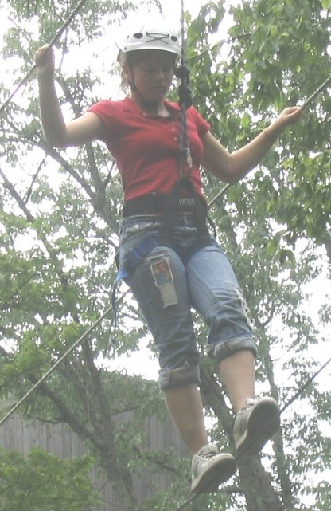
Troop Trip Guidelines
& Procedures
Age Appropriate
Proper Adult Supervision
Planned by Both Girls and Adults
Allow Time to Prepare
Review Safety and Security Guidelines
Troop Trip Notification Form
Camping Trips
Charter Organization Must Approve Trip
Notes:
Troop Trips provide an opportunity to establish and accomplish both long-term goals and short-term objectives for the members of the Troop. Depending on the interests of the girls, the planning of the trip may take a period of weeks, month years. It is the responsibility of Adult Volunteers to guide girls in choosing and organizing a trip that reflects the AHG program, their experience level and the planning ability of the girls.
Trips planned should be age appropriate
There should be proper adult supervision at all times. Girl/Adult ratios must be maintained as well as 2 deep leadership.
Preparation may take time, allow for several meetings.
Review the Health, Safety and Security guidelines found in the AHG Health and Safety guidelines that apply to the activity.
Complete the Troop Trip Notification Form for any trip 75 miles or over from the charter organization and ALL camping trips. Adding any high adventure activity should also be noted on the form. Charter Organization must approve of the trip. Submit this for to your Support Services Coordinator at the AHG, Inc. Office 4 weeks prior to the trip.

Slide 24
Troop Trip Packets
Current Health History Forms of all participants
Medication Administration Form
List of Passengers in cars
List of allergies/medical conditions
List of person in each room, tent, cabin for overnight
Troop Transport Form for all drivers
Parent /Guardian Permission Slips
Notes:
Each Unit Leader should assemble a Troop Trip Packet for each chaperone and driver. It is advisable to carry these at all times in a large zip lock type bag, preferably in a backpack. Each car should have a small first-aid kit. The following items should be included in a Troop Trip Packet:
Current Health History Forms
Medication Administration Form
List of Passengers in cars
List of allergies/medical conditions
List of person in each room, tent, cabin for overnight
Troop Transport Form of all drivers
Parent /Guardian Permission Slips
Directions & maps for destination
Itinerary of events & arrival times.
Photocopy of medical insurance forms & Power of attorney for trips over 200 miles
Troop emergency contact person and phone number
Copy of Emergency Preparedness Plan
Copies of AHG Incident Report Form

Slide 25
Troop Trip Packets
Directions & maps for destination
Itinerary of events & arrival times
Photocopy of medical insurance forms & Power of Attorney for trips over 200 miles
Troop emergency contact person and phone number
Copy of Emergency Preparedness Plan
Copies of AHG Incident Report Form
Notes:
Each Unit Leader should assemble a Troop Trip Packet for each chaperone and driver. It is advisable to carry these at all times in a large zip lock type bag, preferably in a backpack. Each car should have a small first-aid kit. The following items should be included in a Troop Trip Packet:
Current Health History Forms
Medication Administration Form
List of Passengers in cars
List of allergies/medical conditions
List of person in each room, tent, cabin for overnight
Troop Transport Form of all drivers
Parent /Guardian Permission Slips
Directions & maps for destination
Itinerary of events & arrival times.
Photocopy of medical insurance forms & Power of attorney for trips over 200 miles
Troop emergency contact person and phone number
Copy of Emergency Preparedness Plan
Copies of AHG Incident Report Form

Slide 26
AHG Activity Guidelines
Categories of Activities
Unrestricted Activities
Restricted High Adventure Activities
Unauthorized Activities
Notes:
AHG Activities are divided into three categories. These guidelines are available to assist you when planning activities with the girls. Be sure to review this information at “the start” when planning an activity. If an activity is not listed, contact your Support Services Coordinator for approval and guidance.
Unrestricted Activities – are activities that do not require any further notification to the AHG Office. Notification of the charter organization will be charter specific.
Restricted High Adventure Activities – are activities that may require a greater level of knowledge/skill or present a greater risk than usual to participants must be approved by your Support Services Coordinator at the AHG, Inc. Office and the Charter Organization.
If your group is planning such an activity, complete the Troop Trip/High Adventure Activity Notification Form.
Participants must also complete the High Adventure Medical Form prior to the trip. Communicate to parents about the need for a physical well in advance.
All forms are available on the Leader portal area of the AHG website.
Forms must be submitted to your Support Services Coordinator at least four weeks prior to the activity.
Unauthorized Activities are activities that are not approved by AHG and should not be a part of any AHG function.
Review pgs. 116-135 in Unit Leader Handbook or pg. 113-132 in the Coordinator handbook.
(STOP & BREAK) If time allows, stop now and have several leaders talk about an activity they are thinking about planning and review this and report back to the group.
(add page pop up pg .113 in Troop Coordinator handbook)

Slide 27
How to utilize the H&S Section of the Handbook
Annually review the Health & Safety Section of your handbook with the Troop Ministry Team or Leadership Team
Make sure parents & girl members understand the safety guidelines for their chosen activities
Notes:
One of the most important sections of your handbook is the Health and Safety Guidelines. It is so important, that it is recommended the Leadership Team review certain sections on an annual basis, to assist with “remembering” crucial information when providing a safe environment for the girls. Girls should also be included in understanding the guidelines as well.

Slide 28
Questions?
Notes:
Now is the time for the trainer to answer any questions you may have.

Slide 29

Evaluation
Notes:
Thank you for participating in this most important training. As an AHG Leader, you are the primary influencer for the health and impact of the AHG Unit, you have been entrusted with sacred keys.
Let us close in prayer. Dear God, I ask that you commission these ministry workers into Your service. May they make a positive impact on each girl’s life they touch and may their actions reflect Christ’s love. In Jesus name, I pray. Amen.
I encourage each participant to complete an evaluation and return to the trainer prior to leaving. This concludes the final portion of AHG’s Basic Training.

