Slide 1
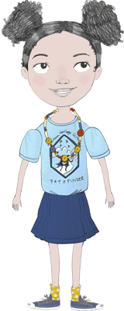
Pathfinder Breakout
Notes:
Welcome to Pathfinder Breakout Training! As a Pathfinder Unit Leader, you are joining the ministry of thousands of volunteers across the country who are building generations of women committed to lives of integrity, faith and service. Your role as a Pathfinder leader will influence the girls and families in your Unit, Troop, and whole community. AHG prays that you will also be challenged and transformed as you lead others.
Whether you are an experienced or brand new Pathfinder Leader, this training session will introduce your role and responsibilities as a volunteer, an overview of the Pathfinder program, and the resources available to you as a Pathfinder Leader.

Slide 2


AHG Foundational Principles
Mission Statement
Building women of integrity through
service to God, family, community and country
Oath
I promise to love God,
cherish my family,
honor my country and
serve in my community.
Notes:
Before beginning to lead the girls in your Unit, it’s important to understand the foundational principles that shape AHG. The American Heritage Girls ministry is guided by the mission statement, AHG Oath, and AHG Creed.
AHG’s mission is “building women of integrity through service to God, family, community and country.” This mission is supported as girls and adults seek to live out the AHG Oath: “I promise to love God, cherish my family, honor my country, and serve in my community.”

Slide 3

AHG Foundational Principles
Creed
As an American Heritage Girl, I promise to be:
Compassionate
Helpful
Honest
Loyal
Perseverant
Pure
Resourceful
Respectful
Responsible
Reverent
Notes:
Finally, the AHG Creed lists specific traits that describe a life of integrity, service and faith: “As an American Heritage Girl, I promise to be compassionate, helpful, honest, loyal, perseverant, pure, resourceful, respectful, responsible, and reverent.”

Slide 4
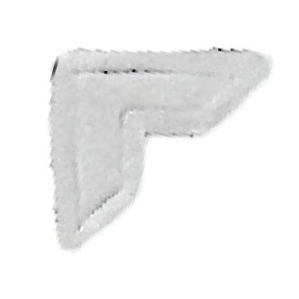
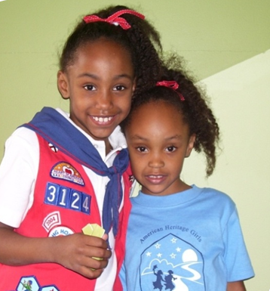
Your Role as Pathfinder Leader
Required Training
KEYS to Child Safety
Basic Training
Actively participate in Troop Ministry Team
Notes:
As an AHG volunteer, you are required to have current KEYS training and also to complete AHG Basic training before your first meeting.
As a Pathfinder Unit Leader, you are a valuable member of your Troop’s ministry team, which consists of all the Unit Leaders in the Troop. Attend any relevant leader meetings so that you can have input into the planning of your Troop’s programming, fundraising, service events, and other activities.

Slide 5
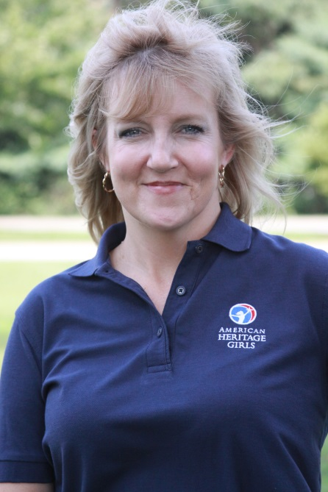

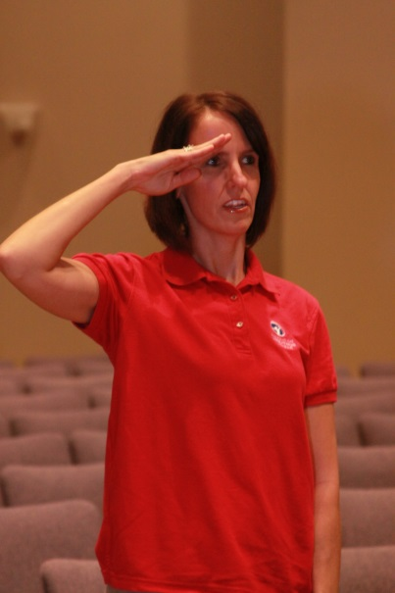

Leader Uniform
Official AHG Leader Polo
or Pathfinder Leader T-shirt
Khaki or navy pants or skirt
AHG membership card & lanyard
Notes:
The official AHG Leader uniform identifies you as an AHG adult member, and signifies that you have a current background check, have completed the necessary training, and are a figure of authority and leadership in your Troop.
The official AHG adult uniform includes: the navy or red official AHG leader polo, khaki or navy pants or skirt, and your AHG lanyard and membership card. Pathfinder Leaders may also wear the Pathfinder Leader T-Shirt while those T-shirts are available.
Finally, you should wear your AHG lanyard and membership card at meetings. These member cards, again, help identify you as a figure of authority who is trained and prepared to protect and serve the members of your Troop.
American Heritage Girls is a uniformed organization and expects that girls will wear their uniforms to regular Troop meetings. An important step in encouraging girls to wear their uniforms is to be committed to wearing your Leader uniform.

Slide 6
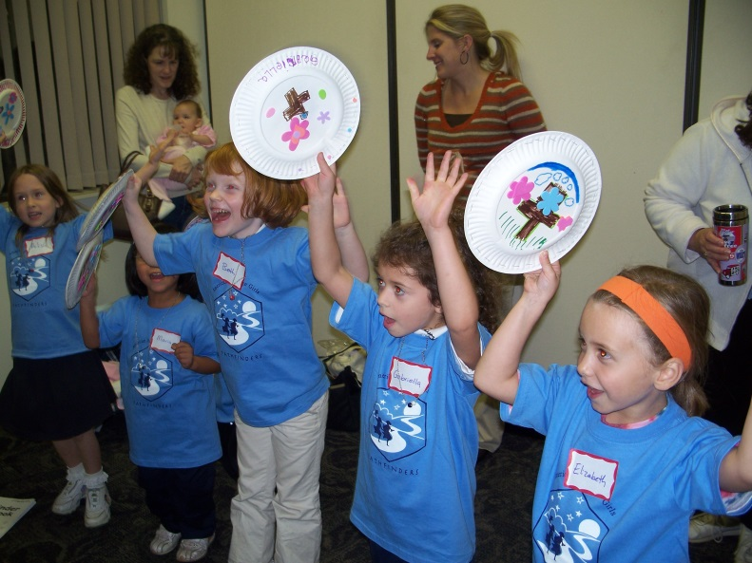

Developmental Needs of a Pathfinder
Creative problem solving
Physical energy
Growing sense of curiosity
Understanding & managing feelings
Social interaction
More information on page 28 Unit Leader Handbook
Notes:
It’s important to remember as a Pathfinder Leader, that the girls in your Unit are in a unique developmental stage. The Pathfinder program is written to address their developmental needs. While each girl certainly grows and learns in a unique way and pace, there are some general developmental characteristics of the Pathfinder age group that are helpful to keep in mind when planning and leading your Unit.
In general, five-to-six year olds are creative problem solvers and are beginning to experience and understand abstract concepts. Allowing your Unit of Pathfinders to try to problem-solve or come up with activity ideas will help them engage in Troop activities.
This age group also has abundant physical energy. Games, crafts, and group activities that give Pathfinders opportunities to be active will also help them engage in Troop meetings.
At this stage developmentally, girls will also have a growing sense of curiosity. Using hands-on experiences to help them understand why and how things happen will help them understand abstract concepts in more meaningful ways. Allow girls to explore topics or ideas that pique their personal interest and be patient when they ask many, many questions.
Finally, five-to-six year olds are beginning to understand and manage their feelings and social interactions with more independence. Give girls the opportunity to form meaningful friendships with one another. Also, allow these girls opportunities to managing their own feelings by giving them time to calm down if upset, or by compromising with one another if there is a disagreement before stepping in to solve their problem.

Slide 7
Pathfinder Progressive Programming
Outdoor (pg 32) | Social (pg 33) | Girl Leadership (pg 35) | Character (pg 36) | Service (pg 40) | Spiritual (pg 41)
Meeting time trips | Games/ Share Time @ Unit Meetings | Snack helper | Participate in parade | Participate in pre-planned project | Prayer during Troop opening
Multi-Troop day camps | Meeting time trips | Craft supply helper | Pray for servicemen and women | On site projects | Songs
Family camping | Day trips w/ parent | Clean up helper | Make cards to send to servicemen and women | In home projects | Memory verses
 | Parent/daughter events | Flag holder |  |  | Participate in prayer circle
 | Parade/ community event |  |  |  | Prayer at Troop closing
Notes:
It’s important that the Troop activities and leaders are aware of the developmental stages of their girls and plan activities accordingly. AHG recognizes the unique developmental stages of each Unit Level and strongly believes in progressive programming. The basic principle of progressive programming asserts that the experiences and opportunities a girl has through AHG should be age appropriate and build in complexity and responsibility as the girl grows. For each of the six AHG program emphases, there is a progression chart which gives examples of appropriate activities for each Unit Level.
This chart lists a few different Pathfinder-appropriate activities for each of AHG’s six program emphases.

Slide 8

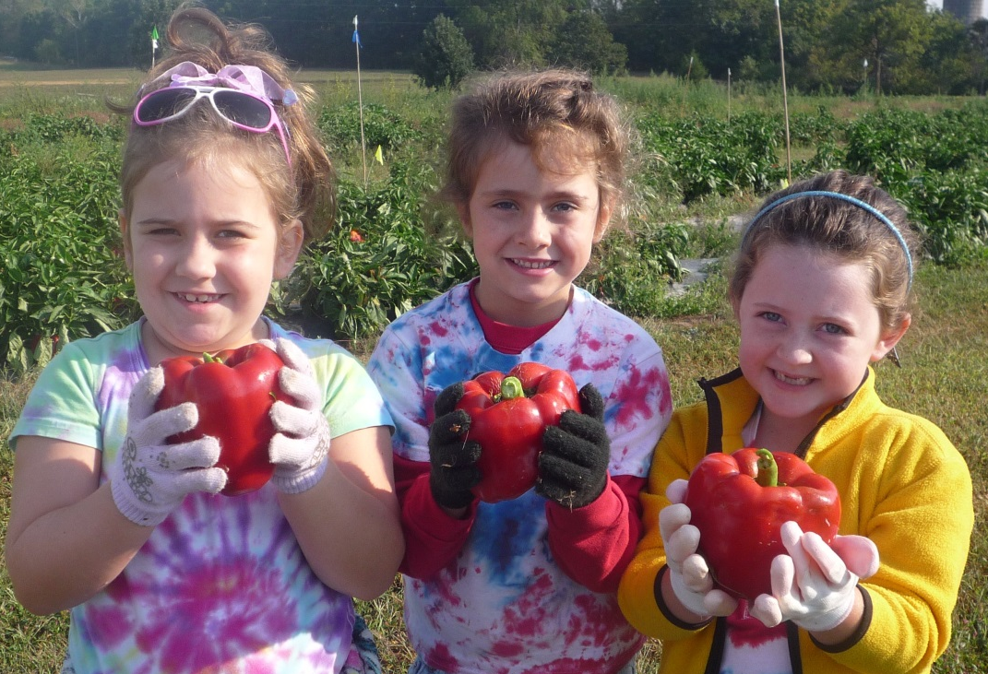

Pathfinders in the troop
Notes:
Having reviewed your basic responsibilities as a Pathfinder Leader and basic characteristics of Pathfinder-age girls, let’s consider how a Pathfinder Unit fits into the larger Troop.

Slide 9

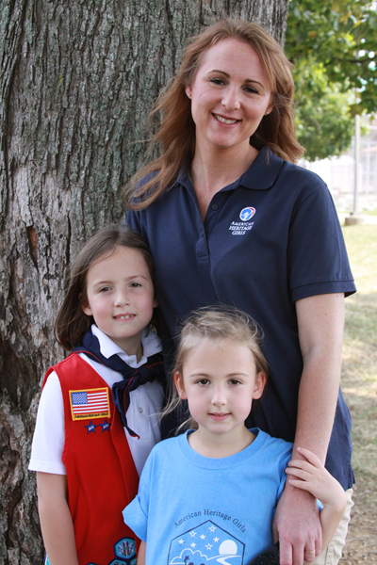
Introduction to AHG program
Teaches AHG Oath & Creed
Introduces families to AHG program
Notes:
The Pathfinder program serves as an introduction to the whole AHG program. It teaches the AHG Oath & Creed to Pathfinder girls and parents. Furthermore, participating in a Pathfinder Unit will introduce families to the broader AHG experience, from service projects to Troop ceremonies to Badge Frontiers!

Slide 10
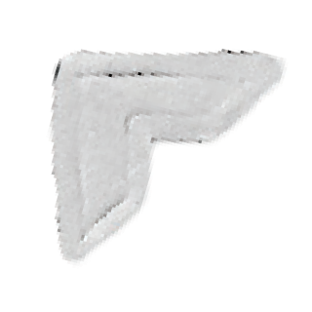
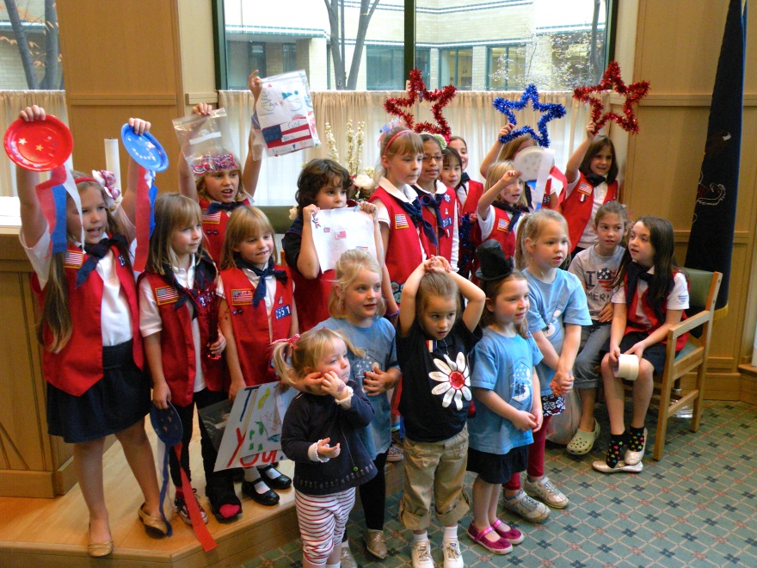
Participating with the Troop
Ceremonies
Social events
Service projects
Outdoor events
(as allowed by Health & Safety)
*remember to use inclusive language when participation
is limited to specific Levels
Notes:
Your Pathfinder Unit should function as a Unit of the whole Troop by participating in larger Troop activities. Pathfinders should be a part of Troop opening, closing, and flag ceremonies. The Troop should also plan social, service and outdoor events that welcome Pathfinder participation.
If a Troop is holding an activity that restricts Pathfinder participation, be sure to use inclusive instead of exclusive verbiage when advertising the event. For example, saying that the whole Troop except Pathfinders is going camping singles out the PF unit for exclusion, versus saying that the Tenderheart, Explorer & Pi/Pa Units are going camping.

Slide 11
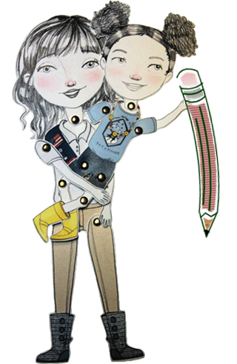
Unit Finances
Work with Troop Treasurer
Remember:
  Dues
  Program Support Fee
  Supplies
  Special trips
Follow Troop budget and policies
Communicate with families
and other leaders
Notes:
If your Troop budget includes a Unit-specific fund, work with your Troop Treasurer to budget for the program year. Your Unit budget should include income from Troop dues and fundraising, and expenses like the Program Support Fee, special field trips and craft supplies.
Work within your Troop policies to communicate your Unit budget to other leaders and families. Follow any Troop policies for requesting reimbursement or further funds.

Slide 12
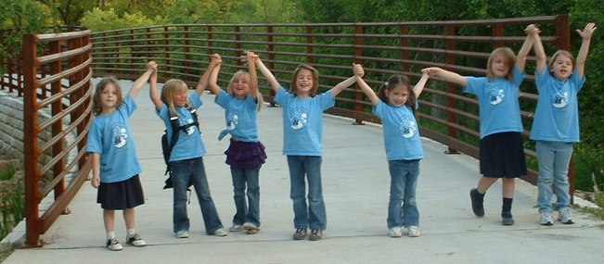
Program overview
Notes:
A Pathfinder’s experience in her first year of AHG will involve many different aspects of the AHG program. Many of those AHG experiences will be shared with girls of other Levels. There are, however, several unique pieces to Pathfinder programming that are not shared with other program levels.

Slide 13
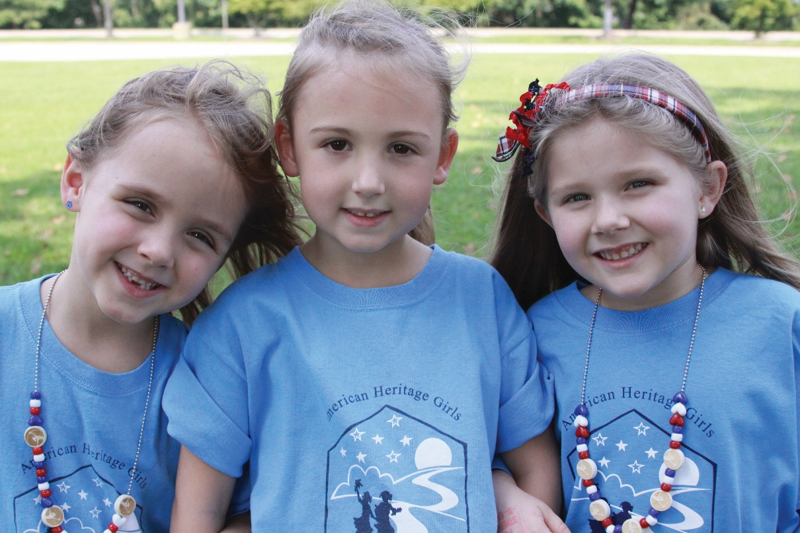
Age Requirement
At least 5 years old
Typically in Kindergarten
Notes:
Pathfinders are required to be five years old at the time they join AHG, and at least by October 31 of the program year. If a girl turns five after the Troop begins meeting but before October 31, she should wait until her fifth birthday to register as an AHG member and begin attending Troop meetings. If a girl has her fifth birthday after October 31, she should wait until the beginning of the following program year to join the AHG Troop.

Slide 14
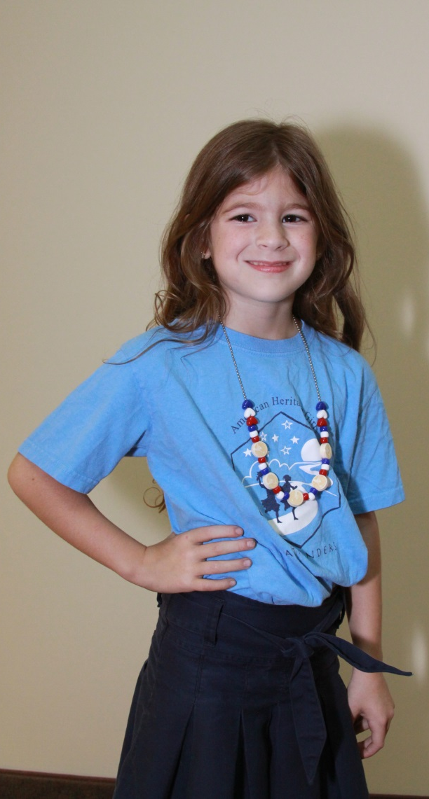
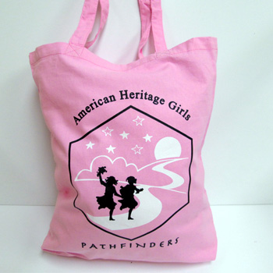
Uniform
Official Pathfinder T-shirt
Navy bottoms (skort, pants, skirt or shorts)
Official necklace
Optional tote bag
Notes:
AHG is a uniformed organization and strongly believes in the unifying benefits of girl uniforms. Part of joining an AHG Troop is wearing the official Pathfinder uniform, which is different from any other AHG girl uniform.
The Pathfinder uniform consists of the official Pathfinder T-Shirt, navy skorts or slacks and the official Pathfinder necklace. The Pathfinder T-Shirt, necklace can be purchased as a kit, which also includes the Pathfinder Handbook, for $28 by individual families on the AHG attic, or Troops can place larger orders through the Leader Store.
The Pathfinder tote bag is not a required part of the official uniform but is a functional addition to the uniform. It gives Pathfinders a specific place to keep their Handbook and other AHG materials together throughout the week. The Pathfinder tote bag is also where any special activity patches a Pathfinder earns should be sewn and displayed.

Slide 15
Necklace
Beads earned during year
  Blue beads: meeting attendance
  Red heart beads: memorizing/learning the Bible verses in each Stepping Stone
  White star bead: service project participation
  AHG logo beads: completing a Stepping Stone
Troop number beads
Notes:
The Pathfinder Necklace, a part of the official Pathfinder Uniform, is made up of beads that signify different parts of the Pathfinder program. Each girl should have her own necklace and add the appropriate beads to it through the program year.
The blue beads represent meeting attendance. Red heart beads are placed on the necklace for each Bible verse a girl learns or memorizes as a part of the Pathfinder program. The white star beads represent service project participation. Troops can determine if Pathfinders will be given a white star bead for each different service project, or will be given a single star to represent all service participation throughout the year. Finally, the AHG logo beads are placed on the necklace each time a girl completes a stepping stone.
The Pathfinder necklace also includes Troop number beads, which help reinforce that the Pathfinder unit is indeed part of the larger Troop. These beads can be placed on the necklace at the first Unit meeting to help girls learn their Troop number.

Slide 16

Handbook
Used exclusively for Pathfinder year
Tracks girls progress through program
Used for only one girl, so she can mark and draw in it
Notes:
In addition to the uniform and necklace, the Pathfinder Handbook is unique to the Pathfinder program. The Pathfinder Handbook is an official publication of AHG, Inc. written to serve both the Pathfinder girl and adult Volunteer. Each handbook contains program guidelines and curriculum and tracks a girl’s progress through the Pathfinder program. These handbooks are purchased through the AHG Attic. Each girl member is required to have a Pathfinder handbook.
The Pathfinder Handbook is a keepsake of the Pathfinder year and is designed for each girl to draw, create and personalize. The Pathfinder Handbook also teaches parents about AHG, and helps them walk through the program alongside their daughters.

Slide 17
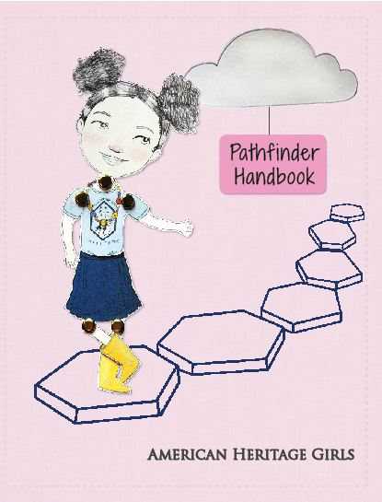
Pathfinder curriculum overview
Notes:
The Pathfinder Handbook contains the whole formal Pathfinder Curriculum, which was revised in 2014 by a national team of volunteers and staff. The Pathfinder curriculum integrates girls into the life of the broader Troop, helps families understand and participate in their daughter’s AHG experience, and provides creative opportunities for girls. Along the way, girls will begin to be shaped into women of integrity as they grow in faith, exploration and compassion. Let’s look at the specific pieces of the Pathfinder Curriculum.

Slide 18
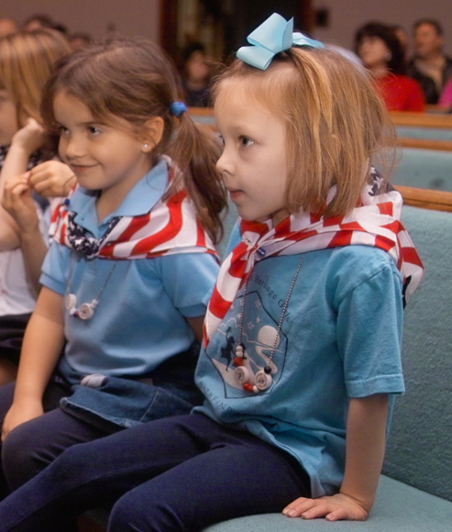

Stepping Stones
6 Stepping Stones
Teach AHG Oath & Creed
Two meetings per Stepping Stone
  can be flexed for Troops who meet less or more often
Notes:
The Pathfinder Curriculum is broken into six “Stepping Stones,” which teach the AHG Oath & Creed. While the structure of the curriculum is written to spread each stepping stone over two Troop meetings, the program can be flexed to meet the needs of Troops that meet less or more often. The Pathfinder Leader Resource Guide has more ideas and information about planning to cover all six Stepping Stones in a program year.

Slide 19
Stepping Stones
Six Elements:
Fanny Facts
Troop Meeting Memories
Creed Word Close-Ups
Bible Verse
Frontier in Focus
Notes:
Each stepping stone contains six different elements:
Fanny Facts, Troop Meeting Memories, Creed Word Close-Ups, Bible Verse, and Frontier in Focus.

Slide 20

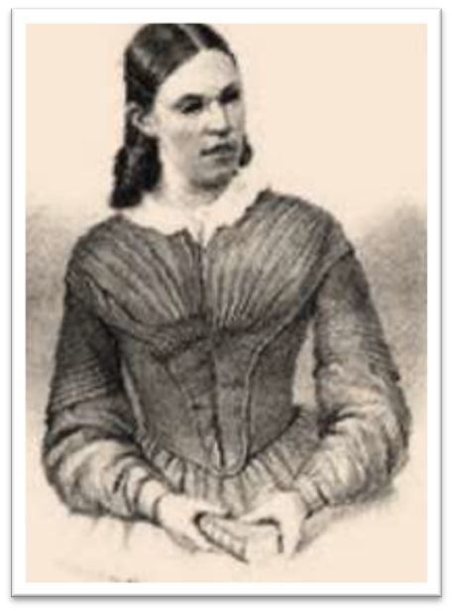
Stepping Stones
Introduce Fanny Crosby
Level Award namesake
19th Century hymn writer
Relate to parts of the AHG Oath & Creed
Notes:
The first element of each stepping stone is “Fanny Facts.” The Fanny Facts, which are written out in the Pathfinder Handbook, introduce girls to Fanny Crosby—the Pathfinder Level Award namesake. Fanny Crosby was a 19th century American hymn writer. When she was an infant, she was blinded by an infection and spent the rest of her life blind. Fanny’s life story provides a model for girls to use the gifts God has given them to positively impact the world around them, even though they are young.
Each “Fanny Fact” relates an area or event in her life to the AHG Oath & Creed. There are small activities or opportunities for personal reflection in each Fanny Facts section.

Slide 21
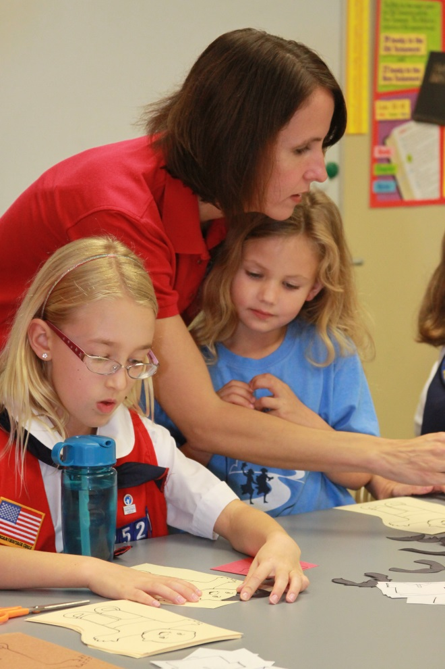

Stepping Stones
Notes:
The second piece of each Stepping Stone is “Troop Meeting Memories.” These pages give girls space to be creative as they remember their Troop meetings, the activities they participate in, the people they meet, and the lessons they learn. The Troop Meeting Memory pages truly make the Pathfinder Handbook unique for each girl as she fills up the pages with her memories.

Slide 22

Stepping Stones
Creed Word Close-Ups
1-2 AHG Creed words per Stepping Stone
Teaches the whole AHG Creed
Helps girls know what the words mean and what it means to “promise to be…”
Notes:
Each Stepping Stone also focuses on 1-2 AHG Creed words. At the end of the Pathfinder program, a girl will have spent time considering each of the AHG creed words. Creed word Close-Ups include small activities, experiments and discussion points and help girls understand more thoroughly what it means to “promise to be…” the words in the AHG Creed.

Slide 23
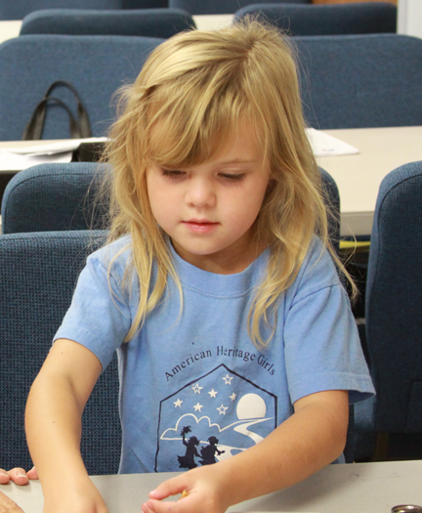

Stepping Stones
Bible Verse
One brief Bible verse per Stepping Stone
Each easy to learn and understand
Relate to Creed Words
“I have hidden your word
in my heart…”
Psalm 119:11
Notes:
There is one brief Bible verse paired with each stepping stone. Connecting the lessons of the Pathfinder program to God’s word help girls understand that their highest calling is not just to do good things, but to do them with a heart that is seeking and following God.
These verses are easy to learn and memorize, helping girls to “hide God’s word in their hearts.” The Bible verses also relate to the Creed Words covered in the same Stepping Stone.
When a girl learns or memorizes the Bible verse for a Stepping Stone, she can add a red heart bead to her Pathfinder necklace.

Slide 24
Stepping Stones
Six AHG Frontiers
Our Heritage
Personal Well-Being
Family Living
The Arts
Science and Technology
Outdoor Skills
Frontier in Focus
Introduces Badge frontiers
One Frontier per
Stepping Stone
Notes:
AHG badges are divided into different frontiers, and each stepping stone introduces one Badge frontier. The Frontier in Focus activities in each Stepping Stone are brief activities that introduce a sampling of Badges from that frontier. They familiarize girls and families with what it will be like to earn Badges in AHG’s upper levels. Girls do not earn entire badges through the Frontiers in Focus part of Stepping Stones.
The six frontiers of the AHG program are: Our Heritage, Personal Well-Being, Family Living, The Arts, Science and Technology, and Outdoor Skills.

Slide 25

Fanny Crosby Award
Pathfinder Level Award
Named for 19th century American hymn writer
Tracking sheet
Notes:
The Pathfinder curriculum culminates in the Fanny Crosby Award, the Level Award for this AHG program level.
The Fanny Crosby Award Tracking Sheet is in the back of both the Pathfinder Handbook and Pathfinder Leader Resource Guide. If earned at the end of the Pathfinder year, the Fanny Crosby Award would be the first Award placed on the Tenderheart vest.

Slide 26
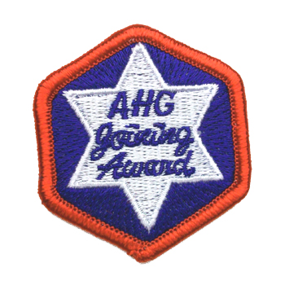
Joining Award
Formally introduces the AHG program
Supplement with requirement
#1 of “Our Flag” Badge
Only after final Stepping Stone
& Fanny Crosby Award
Tracking sheet
Notes:
An optional way to conclude the Pathfinder program is to help girls earn their Joining Award, which formally introduces the American Heritage Girls program to girls of any age or Level. The Pathfinder program satisfies all requirements of the Joining Award with one exception. Units earning the Joining Award will have to add requirement #1 of the Our Flag badge to their planning.
The Joining Award should only be earned as a part of your Troop’s Pathfinder programming after the completion of every Stepping Stone and earning the Fanny Crosby Award. The Joining Award can also be earned at the beginning of the Tenderheart year or any time a girl joins the AHG Troop at an upper level.
A tracking sheet for the Joining Award is available in both the back of the Pathfinder Handbook and Pathfinder Leader Resource Guide.

Slide 27
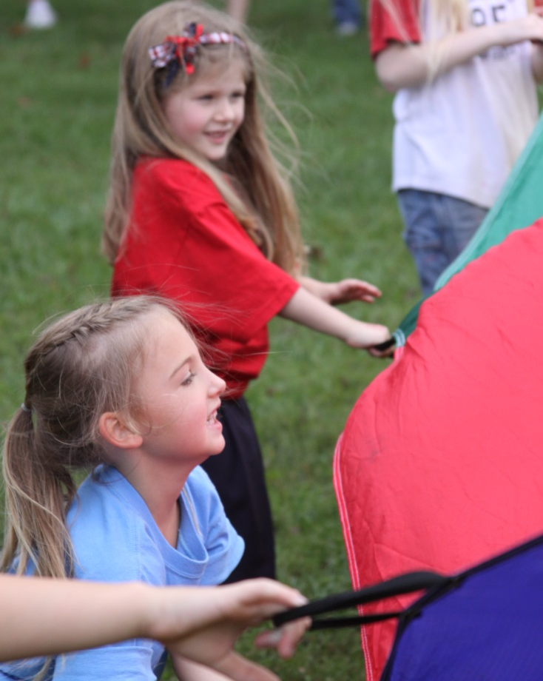
Pathfinder leader resource guide
Notes:
With a thorough reading of the Pathfinder Handbook, it is possible to offer the whole Pathfinder program. However, the Pathfinder Leader Resource Guide is invaluable in helping Pathfinder Leaders understand the different ways they can offer the Pathfinder program, creating detailed meeting plans, and deciding which activities to include in Troop meetings. The Pathfinder Leader Resource Guide, a free resource to AHG adult members, is available for download on the AHG Leader Portal.
Let’s briefly review three of the practical resources included in the Pathfinder Leader Resource Guide.

Slide 28
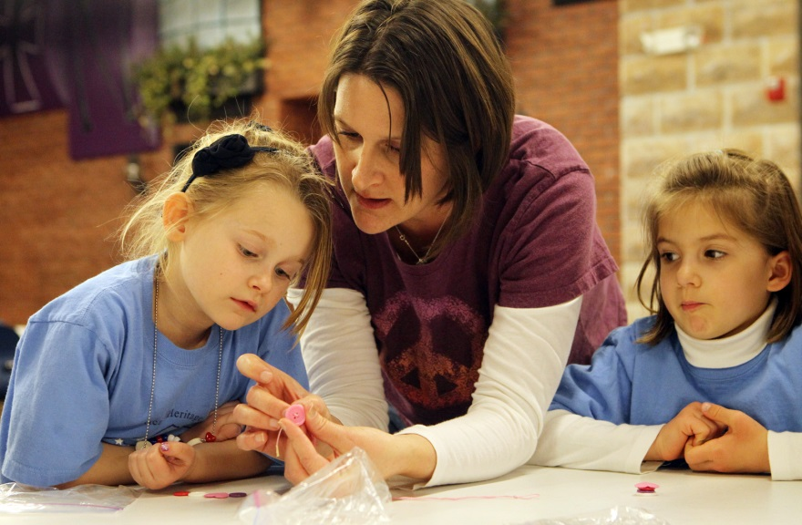
Planning a Meeting
Yearly and weekly guides in Pathfinder Leader Resource Guide
Each stepping stone easily divides into two meetings
Notes:
Pages 6-7 of the PF LRG contain key points to planning and leading a Pathfinder Unit meeting. Then, the LRG provides planning calendars for the whole program year and for each stepping stone. Using these planning resources will help you and the other volunteers in your Unit be on the same page for planning meetings and ensure that each Stepping Stone is covered thoroughly.
The sample year at a glance calendar on page 8 assumes that each stepping stone will be covered over the course of two meetings, but Troops can adjust their planning to match more or less frequent meeting times.

Slide 29

Planning a Meeting
Goal
Main objectives
Supplemental objectives
Bible verse
Creed words
Level Award requirements
Notes:
Each stepping stone of the Pathfinder Program has its own meeting plan, which explains the goal, main and supplemental objectives, bible verse, Creed words and lists the Level Award requirements that are met in each stepping stone.

Slide 30
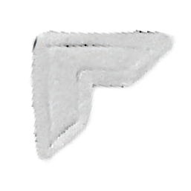
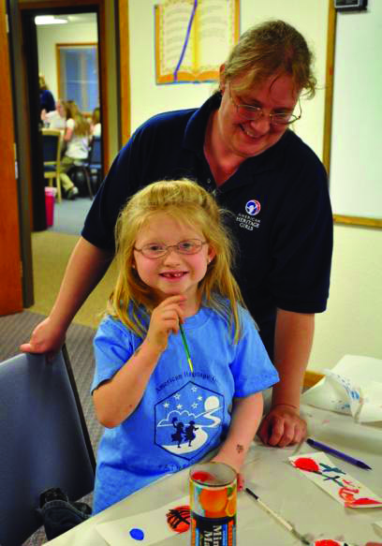
Activity Ideas
Main objective activity ideas
Supplemental objective activity ideas
Stepping Stone Meeting Planner
Notes:
The Pathfinder Leader Resource Guide also includes activity ideas to go with each part of each stepping stone. The suggested activities are divided into main objective activity ideas, which support the key objective of the whole Stepping Stone, and supplemental objective activity ideas, which highlight smaller themes from the Stepping Stone.

Slide 31
Tracking Sheets
Fanny Crosby Level Award
Bible Verse
Service Project
Joining Award
Notes:
Finally, the Pathfinder Leader Resource Guide has copies of all the tracking sheets that related to the Pathfinder Program. Starting on page 38, there are tracking sheets for the Fanny Crosby Level Award, Bible Verses, Service Project Participation, and the Joining Award. These tracking sheets are also available in the Pathfinder Handbook. Make sure families know about these tracking sheets so that parents can help track their daughter’s progress through the Pathfinder program.

Slide 32
Thank you!
Notes:
Thank you for taking the time to learn more about your role as a Pathfinder Unit Leader! Please be sure to review both the Pathfinder Handbook and Pathfinder Leader Resource Guide as a final piece of your training. AHG prays that this training presentation has given you a glimpse into how you can serve as a part of your Troop ministry team, the specific elements of the Pathfinder program, and the resources that are available to assist you in your ministry. The time and heartfelt effort you pour into your Pathfinder Unit will have a profound influence on girls’ lives for years to come!

