Slide 1
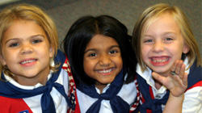
Working With Girls of Varying Abilities
American Heritage Girls
Special Needs Training

Slide 2
Why a Special Needs Curriculum?
Biblical Mandate
AHG is a program of opportunity
AHG wants to equip Leaders as best they can, as to allow this transforming ministry to impact girls of all abilities.
Notes:
AHG is excited to offer a special needs training series for Troop volunteers! Let’s begin by examining why a Special Needs Curriculum is needed for the American Heritage Girls
Biblical Mandate –
We are called to share the good news with all. “Go into all the world and preach the good news to all creation.” Mark 16:15
Jesus was the ultimate includer – he reached out to those in needs, those with physical, mental and emotional disabilities. Jesus showed God’s mercy, kindness, love and hope to not only individuals with special needs, but their families as well. AHG seeks to do the same.
AHG is a program of opportunity – All girls should have equal opportunity to benefit from the AHG program. It is our belief that not only will girls with special needs and their families benefit from this inclusion, but all girls and adult volunteers in a Troop will grow immensely through this opportunity. AHG’s basic premise is full participation for all girls.
AHG wants to equip leaders – AHG wants to help remove the “fear factor” that often impedes making an AHG Troop an environment in which girls of all abilities can learn and grow. AHG also seeks to offer leaders with information, skills and resources that will aid them in successfully integrating girls with special needs into their current AHG program.

Slide 3
Learning Objectives
To understand why accommodating girls with special needs is crucial to not only the AHG mission, but Jesus’ work here on earth.
To give Leaders and adult volunteers the knowledge and resources to effectively create an inclusive troop environment in which girls of all abilities can grow and flourish.

Slide 4
Learning Objectives (Cont’d)
To reduce fear factor of accepting girls with Special Needs into Troop setting.
To give Leaders the tools to reach out to the community, in both education and specific outreach to girls with special needs.

Slide 5
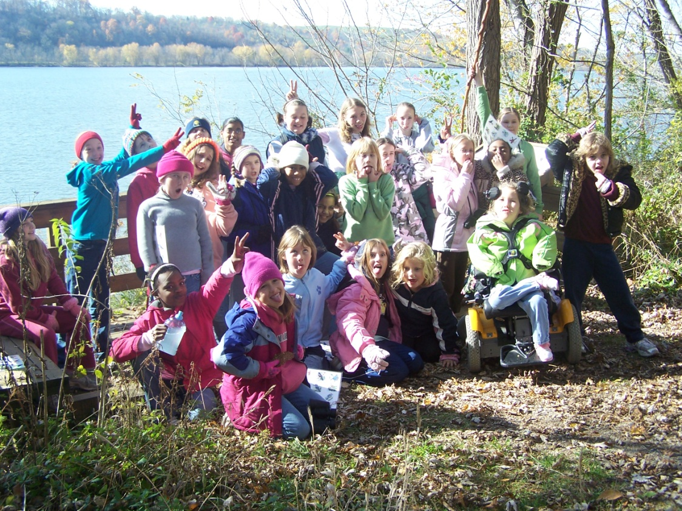
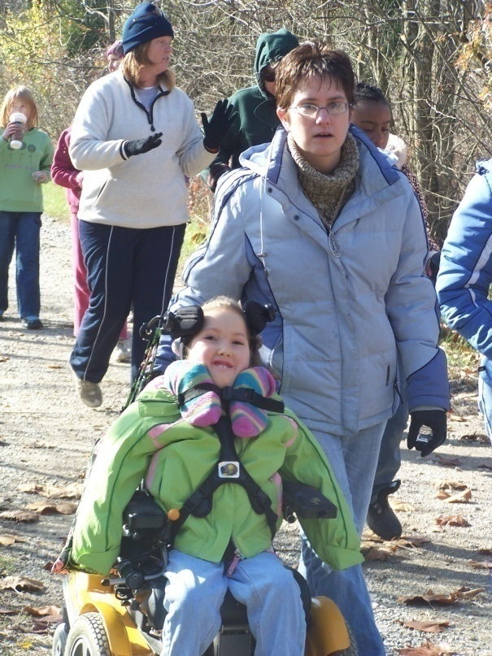
Troop Stories
Asperger Syndrome
Spinal Muscular Atrophy (SMA)
Notes:
Many AHG Troops are already successfully including girls with special needs into their Troop meetings and activities.
A Troop Leader from Ohio says, “One of our Explorers has Asperger Syndrom and fits in fine. She learns by doing and her mom has found the badge work to really assist her with schooling. They are a home school family. She has been a member for three years now and has really come out of her shell, especially with doing things in front of the group.
We have another that has severe challenges due to Spinal Muscular Atrophy (SMA). Emma has been a member of our Troop for the past three years too. She began as a Pathfinder. Due to SMA, her mom or aunt attends the meeting with her. Emma uses a wheelchair and has no motor function of her body. She has a feeding tube and while she can speak, she is hard to understand. In addition, SMA causes her to have a severely low immune system. She only attends meetings in the early fall and late spring. She completes badge work at home with her mom. She can not risk being around groups of people during the flu season. The common cold, if caught, can send her or her brother (He also has SMA) to go to the hospital for weeks.
Our Troop has accommodated this family by making sure our meeting area is handicap accessible and wheelchair friendly. The church where we meet has an area that does not accommodate wheelchairs due to stairs, so we switch the meeting areas around when Emma attends. Emma and her mom or dad have attended Camporee and a few years ago a Troop campout (They came for the day.) They are the most gracious and giving people I have ever met. They are a true inspiration to our Troop families.
In the winter our girls had a special service day just for Emma. They made Christmas card ornaments and sent a video to her of the girls singing carols. A parent dropped it by the family’s home to wish them a Merry Christmas. The year before, all of the girls were asked to make Valentine Cards and mail them to Emma and her brother Nick. (We know how kids love getting things in the mail and new that her brother would like them too.) Our girls/families know of Emma’s immune deficiencies and are very careful to keep their hands clean, sneeze w/cover, etc when she is in attendance.”
What is SMA: http://www.fsma.org/FSMACommunity/understandingsma/WhatIsSMA/

Slide 6
Creating an Environment
Ripe for Inclusion
Building an Inclusive Environment
  What does “inclusive” mean?
Fair vs. Equal
People First
Adult Leadership
Notes:
It is important that the Troop is not only about badge/level award success. Troops should be places to build and practice community as the Body of Christ.
Dr. Richard Lavoie (1989) in How Difficult Can This Be suggest that treating children “fairly” does not mean treating them “equally.” Treating children fairly means giving each child what he or she needs.
It is important that we see all people as individuals with individual strengths and needs v. weaknesses/limitations.
Think, see and say “People First” – this is not about being Politically Correct, but about seeing as Jesus sees. Jesus sees each of us as one of God’s great creations.
Our behavior is influenced by our values and our attitudes. Our language indicates our values and attitudes. When we can start seeing people with disabilities as people first, more like us than unlike us, we stop letting labels dictate our beliefs an our actions, we can create the kind of community Christ had in mind when He said, “Let the little children come to me, and do not hinder them.” Luke 18:16
It is important that as we prepare ourselves to serve families of girls with special needs that we practice some self reflection. What are my biases? What do I truly think about disabilities? What labels do I let control my viewpoint? Once you have recognized any biases, prayer over these biases, asking God to replace them with his vision.
Galatians 6:2, 9-10
Mark 2:1-5 When Jesus saw the paralyzed man, He didn’t see his disability first. He saw a person for whom there was a plan of salvation, Jesus wanted this man to know that he was a child of God. Jesus looked into the man’s heart, not at his body.
Time invested in careful planning will pay off in a more productive and enjoyable experience for everyone. Collaborative planning is especially important. All team members need to participate in the planning process in order for it to be successful. This is also an important time to practice careful selection of volunteers.

Slide 7
Creating an Environment
Ripe for Inclusion
Initial Assessment of Needs
  Interview Sheet
Notes:
Located on Leader Website – the Interview Sheet provides a number of questions to ask parents to ensure that Troop leadership understands the needs of the girl and family. You may need to add additional questions for you specific situation, just remember to be sensitive when asking any questions.
Information should be kept confidential and only released to individuals whom the parents have agreed to share. It will be important that all adults working with the girl understand her needs, so encourage parents to allow information to be shared with appropriate individuals

Slide 8
Creating an Environment
Ripe for Inclusion
Tips for working with families
  Parents
  Siblings
Notes:
Wide range of involvement, feelings, etc.
* Be sensitive – don’t make assumptions, be respectful of their feelings
Learn from parents – they are the experts on their children; ask questions
Help parents feel comfortable & confident their daughter will be loved and cared for
Respite care – often much needed break
Siblings –
Also a wide range -
May need respite care too – allow them to be their own person
Be respectful of feelings

Slide 9
Creating an Environment
Ripe for Inclusion
Acclimating other girls
  Information
  Questions
Notes:
It is very important to acclimate/educate the other girls in your Troop to your new Troop member.
Information –
It is best to educate the girls in your Troop about the special need. Be sure to be age-appropriate when sharing information.
You will need to have parental consent to share information about the girl and her special need. If the girl and/or parents are willing to be the ones to share the information, this is the best scenario.
There may also be a variety of community resources that specialize in disability awareness. Invite groups such as Joni and Friends to come in and share a disability awareness program with your girls.
It may also be helpful to send a letter to parents informing them of any specifics that will help their child understand and welcome her new Troop mate. Again, you will need the consent of the parents to disclose info about their daughter. A sample letter is available on Leader Site.

Slide 10
Addressing Questions
For girl with a special need:
  Find out how the girl’s parents are explaining the specific disability to the girl and to others.
  Help girl find the words to answer others questions for herself
  Find out what the girl wants you to tell other girls
  Teach the girl that she has the right to choose to answer or not to answer another girl’s questions and that she can call on an adult to answer for her.
  Show support for the girl’s feelings about having to answer questions about her disabilities
Notes:
When girls have questions, concerns or misconceptions about the disability, some guidelines:
For the child with the disability:
Find out how the girl’s parents are explaining the specific disability to the girl and to others.
Help girl find the words to answer others questions for herself
Find out what the girl wants you to tell other girls
Teach the girl that she has the right to choose to answer or not to answer another girl’s questions and that she can call on an adult to answer for her.
Show support for the girl’s feelings about having to answer questions about her disabilities

Slide 11
Addressing Questions
For other girls in Troop
  Do not deny differences
  Do not criticize a child for noticing and asking questions
  Listen carefully to questions to understand what girls want to know and answer briefly.
  Do not lightly dismiss children’s expressions of anxiety and fears about disabilities
  Use accurate terminology
  If you do not know the answer, be honest about it.
Notes:
For the typically developing child:
Do not deny differences in the physical or mental abilities of people.
Do not criticize a child for noticing and asking questions about physical and developmental differences.
Listen carefully to questions to understand what girls want to know and answer briefly. Do not belabor the response.
Do not lightly dismiss children’s expressions of anxiety and fears about disabilities
Use accurate terminology when talking with girls about disabilities
If you do not know the answer to a specific question, be honest about it. Tell the children you will try to find the answer during the week and you will get back to them.
From p.44 of Let All The Children Come to Me by MaLesa Breeding, Dana Hood and Jerry Whitworth.

Slide 12
Creating an Environment
Ripe for Inclusion
Acclimating other girls
  Information
  Questions
  Acknowledge
  Activities
Notes:
Acknowledge: Be sure to acknowledge girls who are making an effort to include others, especially when it isn’t easy or comfortable. You might pull her aside and say something like “Emily, I know this wasn’t your most fun Troop meeting, but I really saw Jesus in you tonight. You were patient and kind to Ann. Those are fruits of the Spirit that I could tell God gave you tonight. Thank you so much for how you treated Ann.”
Activities: There are a variety of ways to implement activities that promote disability awareness.
Programs like Joni & Friends and Everybody Counts offer curriculum for awareness.
You can also come up with your own activities by Pairing Jesus’ healing miracles with exploring various types of assistive equipment.
Devotions – a few examples on the Leader Site
Children’s books – at the end of presentation are a few examples

Slide 13
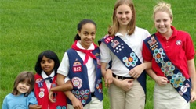
Meeting the Need
Range of Abilities
  Learning styles
    Auditory
    Visual
    Kinesthetic
  Developmental differences – between age groups
Notes:
Though Girls with special needs learn and interact differently, every Troop, whether or not it includes children with disabilities, has a range of abilities present. Learning styles differ, there are development differences between age groups, etc. Just as we adapt programming to meet the needs of different age groups, we must also seek to meet special needs.
The picture of Jesus the Good Shepherd is a powerful image. When we wonder if we should go to all this trouble for one child when we have so many other in our Troops, we need to remember that we serve a Savior who left the 99 to find the one that was lost. No child is unworthy of our every effort to help her succeed. From P.41 of Let All the Children Come To Me by MaLesa Bredding, Dana Hood, and Jerry Whitworth.
Galatians 6:2, 9-10
²Carry each other's burdens, and in this way you will fulfill the law of Christ. ⁹Let us not become weary in doing good, for at the proper time we will reap a harvest if we do not give up. ¹⁰Therefore, as we have opportunity, let us do good to all people, especially to those who belong to the family of believers.
Depending on the nature and level of their challenge, if they are given alternative ways to explore and express their understandings, many children can learn the same things as their typically developing peers.
Information on learning styles and developmental differences between age groups can be found on the Leader Site.

Slide 14
Casey’s Story
Notes:
Voices from the classroom : Casey – Casey enters the hallway from the outer door. He is screaming with his hands held over his ears. This Casey’s usual entrance into King David’s Kids. His adult buddy escorts Casey into a small room nearby. In this room Casey’s buddy shows him a “social story” that says, “I will stop screaming. Now I am ready to play.” The words have pictures above them so that Casey can interpret the written message as it is read to him. Casey immediately becomes calm, looks at his buddy, and places his hand on the doorknob indicating he is ready to enter into the playroom with the other children. We still don’t know why Casey screams when he enters our hallway. His language isn’t developed well enough to tell us. His hands over his ears give us a clue however. The hallway is a narrow entry area. As Casey enters, the hallway is crowded with the parents of the other children who have stopped to greet each other.
So you may be asking - What about needing to be out of the room for loud songs, etc? But don’t we want these children to learn something? Yes. We want them to learn that they are safe and that they can be happy in this place. Later, they can learn the content of what is being taught. Casey may not learn tonight that Noah built an ark, but he will learn, at the very least, that he is loved and included. Which lesson is more important for Casey to learn?
Often, more than learning new skills girls with special needs just need someone who has the commitment, compassion, and courage to reach out and connect with them. They need someone to touch not only their minds, but to also touch their hearts and souls, to break down the walls and stereotypes, to look beyond the obvious, and see what lies beneath.
Adapted from p.13 of Let All the Children Come to Me by MaLesa Breeding, Dana Hood and Jerry Whitworth.

Slide 15
Modifying the AHG Program
Build on strengths
Assume 100% inclusion
  To determine level of inclusion ask
    Can the girl do the same activity at the same level as peers? IF NOT
    Can the girl do the same activity but with adapted expectations? e.g. less words. IF NOT
    Can the girl do the same activity with adapted expectations or materials? IF NOT
    Can the student do a similar activity but with adapted expectations? IF NOT
    Can the student do a similar activity but with adapted materials? IF NOT
    Can the girl do a different, parallel activity? IF NOT
    Can the girl do a different activity in a different section of the room? IF NOT
    Can the student do a functional activity in another part of the building?
    (from David Gaston of Olympia School District in Olympia, Washington)
Always move from inclusive to exclusive
Notes:
Throughout the Gospels we see Jesus’ ability to identify and build on people’s strengths. He doesn’t see the disability, he sees potential –we should model this behavior within our Troops
Build on strengths-
We must begin by identifying the girls’ strengths. The following is an example of the importance of starting with strengths instead of weaknesses.
Kathy is a 13-year old girl who has Down Syndrome. Her IQ is 52, in the moderate to low range of mental retardation. Her language skills, both expressive and receptive, are at a 5 ½ year-old-level. Her basic reading skills are very minimal. She has difficulty focusing on a task for a very long period of time. She does not follow oral directions well and needs almost constant supervision.
Lynne is a young teenager who likes being with other children her age. She is very friendly and out-going. She is very good at remembering details and learns well visually and can complete tasks that are part of the daily routine. She has a lot of curiosity and likes doing things independently. She enjoys looking at pictures, doing crafts and singing.
Both describe Kathy Lynne – by the first description we would wonder how she could ever be included in regular Troop activities, but using the second we can see that she has a number of strengths that would help her be successful in a Troop setting.
Assume 100% inclusion: Begin by presuming that the girl will be able to remain with all the other children and then ask “How can I modify the setting, activity, methods, etc. to allow this girl to be included?”
Often, girls of all abilities need more than learning new skills – they need someone who has the commitment, compassion, and courage to reach out and connect with them. They need someone to touch not only their minds, but to also touch their hearts and souls, to break down the walls and stereotypes, to look beyond the obvious, and see what lies beneath.

Slide 16
Modifying the AHG Program
Girls can be working on a number of different levels within the Troop meeting:
Work on the same task with the same materials (no adaptations needed)
Work on the same task, but an easier step
Work on the same task, but with different materials
Work on the same theme (objective), but a different task
Work on a different theme and a different task
Notes:
That being said, there are often ways to modify the program, or its delivery so that girls may not only feel loved, but glean a new skill as well.
Program Modification
Girls can be working on a number of different levels within the Troop meeting:
Work on the same task with the same materials (no adaptations needed)
Work on the same task, but an easier step
Work on the same task, but with different materials
Work on the same theme (objective), but a different task
Work on a different theme and a different task

Slide 17
Modifying the AHG Program
When choosing to modify an activity focus on what the girl CAN do
Modify, adapt or accommodate before changing the activity
Use the least obtrusive support first
Use age-appropriate materials, goal and activities when planning how to adapt
Not all girls learn the same thing, in the same way, at the same time and that is OK!
Notes:
That being said, there are often ways to modify the program, or its delivery so that girls may not only feel loved, but glean a new skill as well.
When choosing to modify an activity
Focus on what the girl can do
Modify, adapt or accommodate before changing the activity
Use the least obtrusive support first
Use age-appropriate materials, goal and activities when planning how to adapt
Not all girls learn the same thing, in the same way, at the same time and that is OK

Slide 18
Types of Modification
Input Variations
Output Variations
Alternative Goals
Size of Assignment
Extra Time
Level of Difficulty
Support Needs
Active Participation
Alternative Curriculum
Notes:
Types of Modifications:
Input Variations, Output Variations, Alternative Goals, Size of Assignment, Extra Time, Level of Difficult, Support Needs, Active Participation, Alternative Curriculum
With all modification it is important to identify the goal of the activity and ensure that the modification will still allow the goal to be met. Want to challenge girls, but not set them up to fail.
Some modifications –
*Allow children with attention or developmental challenges to hold a “fidget” toy during group time to help keep them physically occupied.
*If you have girls with physical challenges, use larger pieces of paper allowing them to use large movements associated with less mature developmental levels. Some girls might also do better if the paper is mounted to a wall or on an inclined surface while they work.
Other ideas – The Inclusive Early Childhood Classroom: Easy Ways to Adapt Learning Centers for All Children by Patti Gould and Joyce Sullivan. Created for early childhood classrooms, but can easily be adapted.
Don’t forget that the girl’s parents know her best! If you have an activity planned, don’t hesitate to ask them how they think their daughter could best participate.

Slide 19
Spirit of the Badge
With all modification it is important to identify the goal of the activity and ensure that the modification will still allow the goal to be met. Want to challenge girls, but not set them up to fail.
Found in Unit Leader Handbook
Notes:
With all modification it is important to identify the goal of the activity and ensure that the modification will still allow the goal to be met. Want to challenge girls, but not set them up to fail.
Spirit of the Badge
AHG’s Spirit of the Badge guidelines can be found in the UL Handbook and offer Leaders some flexibility in badge requirements. Leaders may slightly adapt requirements to meet the needs of their girls as long as the overall goal of the requirement is still met. Your Support Services Coordinator can assist you with any questions regarding this policy.

Slide 20
Choosing the Appropriate Modification
Using a Team Approach
  Parents
  Special Ed teachers – IEP (Individual Education Plan)
    AHG support school IEP
    School support AHG program
  Doctors
  Therapists
  Etc.
Notes:
The modifications implemented will likely be different in each case, so it is important to tailor these modifications to the specific needs of the girl. Utilize her current support systems to come up with an effective plan.

Slide 21
Level Award Modification Process
Step One –Family Interview (Unit Leaders and Troop Coordinator should be involved)
Step Two – Consult with professionals involved in care, to ensure program becomes a supportive piece of wraparound care, if applicable.
Step Three - Develop an Individualized Achievement Plan (IAP) based on AHG guidelines for program modification
Step Four – Have IAP reviewed by National Special Needs Committee
Step Five – IAP is implemented. Unit Leaders in continual communications with parents, making adjustments to IAP as needed.
Step Six – Award Recognition
Notes:
In an effort to keep consistency in Level Awards, AHG has created a process for modification approval when it comes to Level Awards.
This process will enable the modification to be girl specific, encourage success and keep the integrity of the AHG program intact.
A few reminders as you begin this process.
* The Parent/Guardian Interview From should be used to guide the family interview.
* Wraparound care professionals may include teachers (with knowledge of girl’s IEP), therapists (occupational, speech, mental health, etc.) mentors, social workers, doctors/medical professionals, etc.
* The IAP should be considered a fluid document, that can be altered as girl needs change.
* Troop Leadership is encouraged to bring questions/concerns to their Support Services Coordinator, and to network with community resources.
AHG, Inc. seeks to create an inclusive Troop environment in which girls of all abilities can learn and grow. This goal is crucial not only to the mission of AHG, Inc., but also to the Great Commission.
Additional questions about this process can be sent to program@ahgonline.org

Slide 22
Common Concern
It just won’t be fair when I do special things for her that I don’t do for the other girls.
Notes:
Common Concern – It just won’t be fair when I do special things for her that I don’t do for the other girls.
This concern comes from a misunderstanding of what it means to be fair. Remember, fair does not mean doing the same thing for everyone, but doing what everyone needs. Here’s a story to illustrate this: Imagine that you go to the doctor’s office. Perhaps you are afraid that you have pneumonia. When you get into the treatment room the doctor says, “Well, let’s get a cast put on that let.” You obviously protest saying that you do not have a broken leg.
The doctor replies that the first patient he saw on that day had a broken leg and required a cast. In his commitment to be “fair” to all his patients, he has to do the same thing for everyone.
So “fair” should mean that we will make every effort to adapt what we do to meet each individual child’s need. Girls might complain, but they will nearly always understand if we take the time to explain that “I am going to do my best to do what everyone in our Troop needs. I am going to give Julie what she needs, and I am going to give you what you need.”
Adapted from p.42 of Let All the Children Come to Me by MaLesa Breeding, Dana Hood and Jerry Whitworth.

Slide 23
Resources
Local Organizations
Books:
Helping Kids Include Kids with Disabilities by Barbara J. Newman
Let All the Children Come to Me by MaLesa Breeding, Dana Hood & Jerry Whitworth
Exceptional Teaching by Jim Pierson
Websites:
Joni & Friends – www.joniandfriends.org
National Dissemination Center for Children with Disabilities http://www.nichcy.org
Children’s Books:
In Jesse's Shoes By: Beverly Lewis
Views from Our Shoes: Growing Up with a Brother or Sister with Special Needs
By: Don Meyer
Don't Call Me Special: A First Look at Disability by Pat Thomas
Since We're Friends: An Autism Picture Book by Celeste Shally
Notes:
Joni & Friends – Christian disability awareness curriculum; free audio teachings – great topics

Slide 24
Conclusion – Community is a Verb!
The greatest resource any Troop has is its community, rallying around one another in love and support.
AbleNet Consortium for Excellence in Special Education (2004) defines community as a place where all [girls]:
  Experience a sense of belonging, caring and respect
  Have a growing network of meaningful relationships
  Look forward to each day because they have ongoing opportunities for relevant choices and shared fun
  Know that their voices and opinions are acknowledged and valued
  Experience an increasing sense of competence as they grow in awareness of their gifts and talents
  Know they contribute something unique, as they learn from each other.
Notes:
The greatest resource any Troop has is its community – rallying around one another in love and support.
AbleNet Consortium for Excellence in Special Education (2004) defines community as a place where all [girls]:
Experience a sense of belonging, caring and respect
Have a growing network of meaningful relationships
Look forward to each day because they have ongoing opportunities for relevant choices and shared fun
Know that their voices and opinions are acknowledged and valued
Experience an increasing sense of competence as they grow in awareness of their gifts and talents
Know they contribute something unique, as they learn from each other.
Joyce Eckes (2004) “I like to think about community as a verb. It is honoring every voice, creating ways for being and learning together, reaching out with respect and care, displaying everyone’s work in the classroom, and nurturing each others’ gifts and talents. It is creating fun and a sense of play, gathering and listening to each others’ questions, telling and listening to stories from significant moments in each other’s lives, celebrating the little things, sharing books, movies, experiences and gaining courage as we learn and grow together. It is knowing that over time we are stronger for this and that we are not alone and that we are indeed part of something more and bigger than ourselves – something that makes living and learning a wondrous and beautiful miracle every day!”

Slide 25
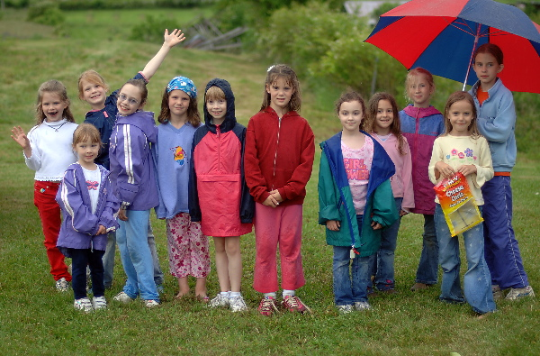
Questions?

