Slide 1
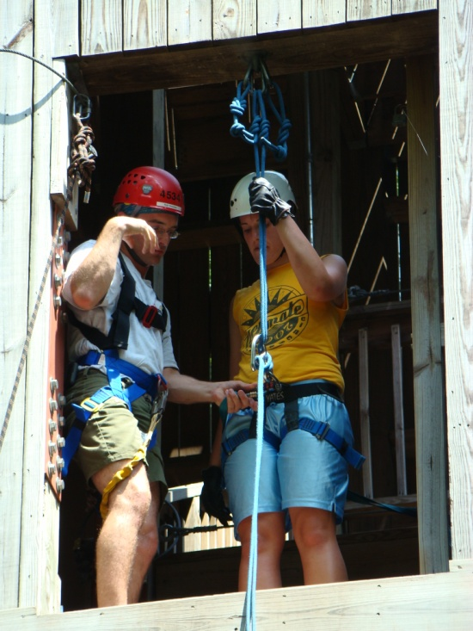
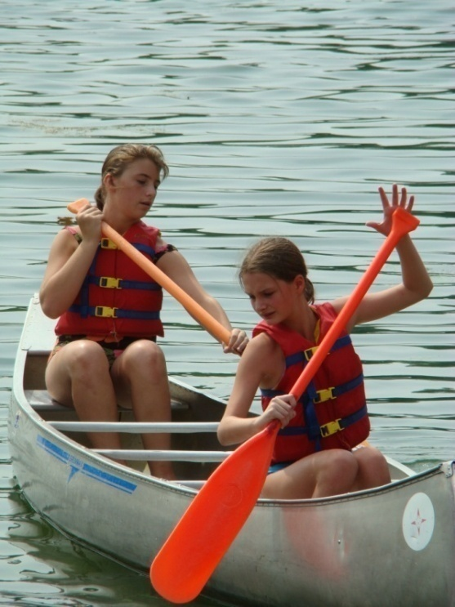
Pioneer/Patriot
Breakout Training
Notes:
Group Training with a Trainer – The notes provided on each slide are to assist you with presenting the material in this training. Be sure that all content that is explained in the notes is shared with the audience. Group Breakout Session Activities are included in this training. Information regarding the facilitation of the breakout session is available on the Breakout Session Guide. This guide is located on the Training section of the Leader Area of the AHG Website as well as on the 2009 Training Resource CD.
“Welcome to the American Heritage Girls Pioneer/Patriot Breakout Training. As a Unit Leader and primary influencer for the health and impact of the AHG Unit, you have been entrusted with sacred keys.
American Heritage Girls is a ministry for girls that has been developed to glorify God and to bring girls into a stronger relationship with Him. Over the years, AHG has impacted thousands of girls and families’ lives. You will be an influencer on the lives of the volunteers and girls within the AHG unit and the local ministry. You will be changed forever as you begin and continue to serve in this transforming organization.”

Slide 2
Introductions
Notes:
“I would like to introduce myself, I am _______________________. I will be your trainer for today.” [Tell about your background Have each participant introduce themselves. After this is complete, officially open the training with prayer.
“Let’s open this training with prayer.” [pray]
“Much of the information that is discussed during this training is available in the 2008 edition of the AHG Unit Leader Handbook. It is strongly encouraged that each Unit Leader own a current version of the Unit Leader Handbook. “

Slide 3
Training Objectives
Training helps Leaders:
  Gain knowledge about the AHG Program
  Develop positive attitudes
  Learn the skills they need in order to be successful
  Utilize resources available to them to provide a quality worthwhile program
  Gain confidence to carry out their responsibilities
The end result?
  Girls will receive a program designed to achieve AHG’s mission and vision for tomorrow.
Notes:
“Training helps Leaders:
Gain knowledge about the AHG Program
Develop positive attitudes
Learn the skills they need in order to be successful.
Utilize resources available to them to provide a quality worthwhile program.
Gain confidence to carry out their responsibilities.
And the end result?
Pathfinder, Tenderfoot, Explorer, Pioneer and Patriot girls receive a program designed to achieve AHG’s mission and vision for tomorrow.”
Thank you for taking the time to be trained today.

Slide 4
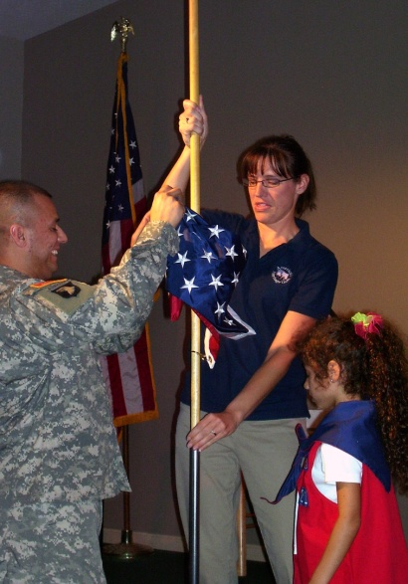
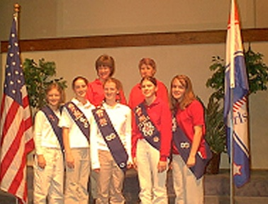
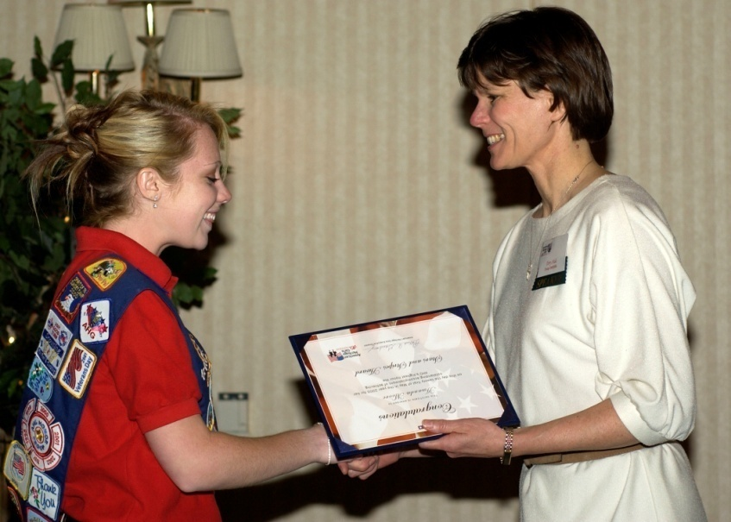
Role of A Unit Leader
Notes:
“We want to congratulate you on your selection as a Unit Leader for your local AHG troop. As was said earlier, you are the primary influencer for the health and impact of the AHG Unit and have been entrusted with sacred keys.”
“The Unit Leader’s role is not meant to be done alone or in a vacuum. The Body of Christ is made up of many parts which create the whole. The same is true of the American Heritage Girls. With this in mind, your journey with the American Heritage Girls’ ministry will be one of spiritual growth, personal fulfillment and relationship building. May you be richly blessed as you glorify our Lord while serving our nation’s daughters.”

Slide 5
About AHG
Notes:
“American Heritage Girls is a Christ centered non-profit scouting ministry for girls ages 5 – 18. The AHG program is built upon six Program Emphases that address the spiritual, mental, physical and social needs of today’s young woman. The American Heritage Girls is a non-denominational ministry which believes in partnering with local Christian churches, para-churches and private schools in order to accomplish its mission. “

Slide 6
Getting Started
Notes:
“Whether you are a new or seasoned Unit Leader, this training will help you start working with girls at the Pioneer/Patriot levels. It is important that you review the AHG Unit Leader Handbook in addition to participating in this training. AHG’s Oath, Mission statement, Vision and Statement of Faith are provided to you as a basis for your programming. This information can be found in the Unit Leader Handbook for your reference.”

Slide 7
The Oath
I promise to love God,
Cherish my family,
Honor my country,
And serve in my community
Notes:
“The AHG Oath is, I promise to love God, Cherish my family, Honor my country, And serve in my community.” As you can see the AHG Oath has four parts. When a girl raises her four fingers, each finger represents a part of the oath. Take a moment to say the oath with your four fingers raised. Girls should say the oath at each meeting during an opening flag ceremony. There are some fun ways to help girls learn the oath as part of their activity time. Be sure to look through the Joining Award Leader packet for some suggestions. Ideas can be found in the Unit Leader Handbook or leader area of the AHG website. “

Slide 8
The Creed
As an American Heritage Girl, I will be:
Compassionate
Helpful
Honest
Loyal
Perseverant
Pure
Resourceful
Respectful
Responsible
Reverent
Notes:
“The AHG Creed provides ten character virtues that each girl should strive to achieve as a young woman of integrity. These ten virtues were selected to reflect the ten commandments of the Bible. The Creed should also be incorporated into an opening flag ceremony at each regular troop meeting. When reciting the Creed, girls stand at attention with their hands at their side. There are many fun ways to help girls learn the creed virtues. They too can be found in the Unit Leader Handbook or the Joining Award Resource packet.”

Slide 9
The Mission Statement
Building women of integrity through service to God, family, community and country.
Notes:
American Heritage Girls mission is to ‘build women of integrity though service to God, family, community and country”. Each leader & girl are encouraged to know the mission of AHG.

Slide 10
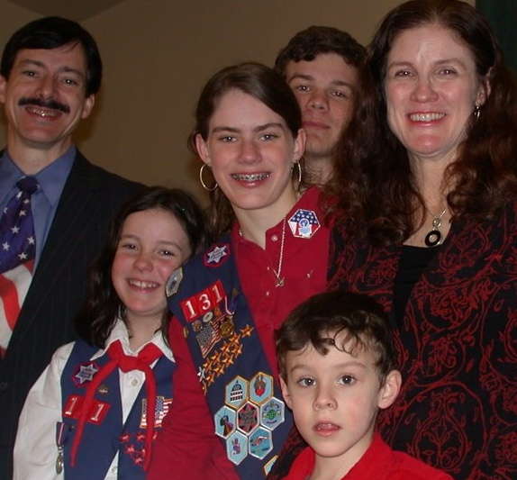
Our Vision
American Heritage Girls is the premier scouting organization for young women that embraces Christian values and encourages family involvement.
Notes:
American Heritage Girls’ vision is to be the premier national scouting organization for young women that embraces Christian values and encourages family involvement. The time is ripe in our country to counter the culture and raise a generation of girls who will lead hopeful, joy filled, transformed lives.

Slide 11
Our Statement of Faith
The AHG Statement of Faith applies to ALL American Heritage Girls’ Charter Organizations, Adult Members and Adult Volunteers.
We believe that there is one Triune God - Father, Jesus Christ His one and only Son and the Holy Spirit - Creator of the universe, eternally existent. We believe the Holy Scriptures (Old/New Testament) to be the inspired and authoritative Word of God. We believe that each person is created in His image for the purpose of communing with and worshipping God.
We believe in the ministry of the Holy Spirit who enables us to
live a Godly life. We believe that each individual is called to
love the Lord their God with all their heart, mind, soul
and strength; and to love their neighbor as themselves.
We believe that each individual is called to live a life of
purity, service, stewardship and integrity.
Notes:
AHG provides its membership with a Statement of Faith. It is important that all members of the Leadership Team are in agreement with the foundation principles of American Heritage Girls. We encourage Leadership Teams to review annually the AHG Statement of Faith.

Slide 12
Program Levels
Pathfinder – 5 years old and in kindergarten
Tenderfoot – 6 years old and in 1st through 3rd grade
Explorer – 9 years old and in 4th through 6th grade
Pioneer – 12 years old and in 7th through 8th grade
Patriot – 14 years old and in 9th through 12th grade
Notes:
American Heritage Girls program strives to offer a well-rounded program to its members. Troops are to be comprised of multiple-levels. Program levels are divided by age and grade. It is important that girls participate in the program at the level appropriate for the age that is required.
Trainer Note: Review the levels and ages/grades above with participants.

Slide 13
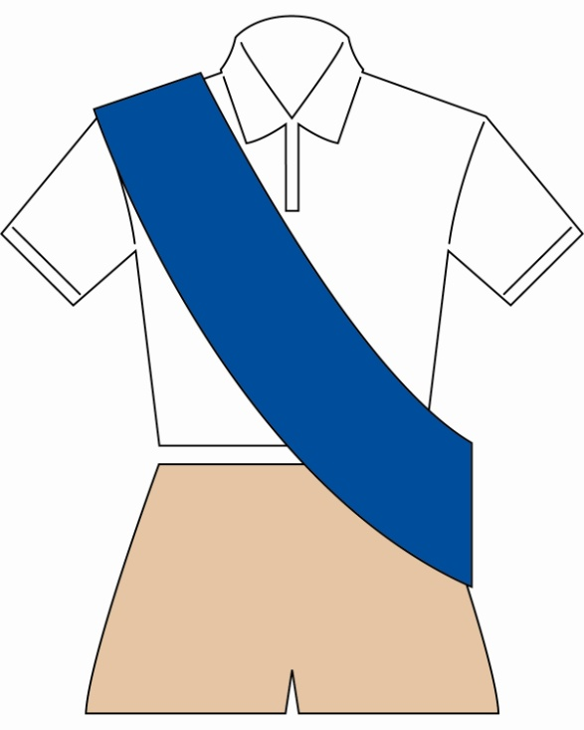
Uniforms
Pioneer
Notes:
“The American Heritage Girls is a uniformed organization. Members wear their uniform to all AHG Activities. Wearing the AHG uniform gives members a sense of identity and equality, encourages good behavior and allows the community to recognize the scouting ministry which it represents.
Guidelines regarding uniform pieces can be found in the AHG Guide to Ordering Merchandise available on the Coordinator CD, AHG website or the AHG Girl Handbook on pg. 16. Badge and insignia placement standards can be found on pg. 28 and 29 of the Girl Handbook.”
Pioneer Uniform consists of:
Official AHG White Polo or long sleeved mock turtleneck
Official AHG Navy
Khaki slacks* or skirt
* Slacks should be dress slacks, with no pockets on the legs.”

Slide 14
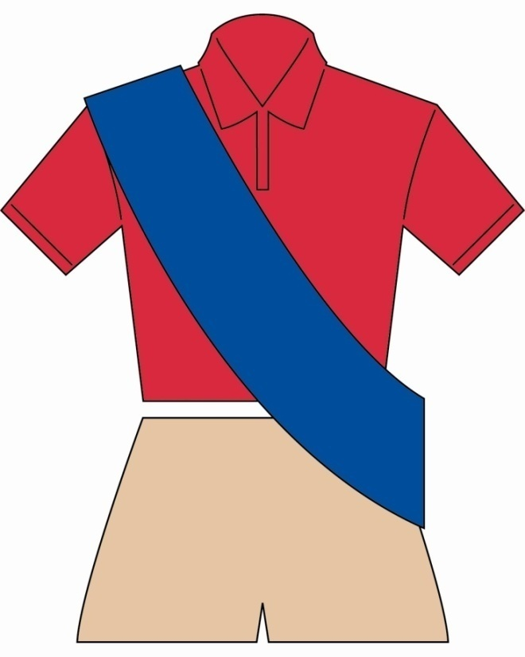
Uniforms
Patriot
Notes:
“Patriot Uniform consists of:
Official AHG Red Polo or long sleeved mock turtleneck
Official AHG Navy Sash
Khaki slacks* or skirt
* Slacks should be dress slacks, with no pockets on the legs.”

Slide 15
Working with Girls
“First and foremost, let them be children! Encourage situations where they can succeed. When they succeed, they gain self-confidence.”
AHG Unit Leader Handbook
Notes:
“It is important that when planning programming, we do so in a progressive nature. Programs and activities should involve girls at the skill and understanding levels they are capable of handling. Giving girls just enough, without overwhelming them will assist in their overall development.”

Slide 16
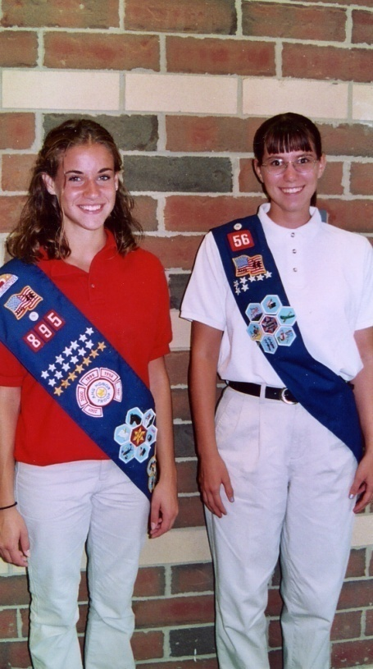
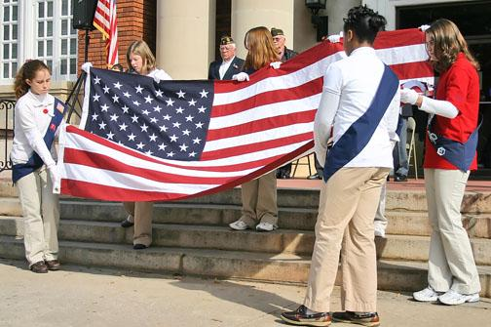
Girl Development
Notes:
“The way in which a girl progresses through the AHG program should be based upon a girl’s physical, emotional, social, intellectual and spiritual maturity. Programs should meet girls where they are developmentally, in order for them to learn and mature effectively. Working with Pioneers will be very different than working with Patriots and the planned activities should reflect this difference. A Developmental Cues Chart is provided to you in the Unit Leader Handbook on page 28 & 29 and on the Unit Leader Handbook CD. AHG provides progression charts for all six parts of the program to assist a Unit Leader with helping girls at this level plan age appropriate activities. These charts can be found in the 2008 Unit Leader Handbook. “
Trainer Note: Have everyone turn to pgs. 28 & 29 and review a sample of the Pioneer &/or Patriot abilities (depending on who is being trained).

Slide 17
Program Emphases
  Life Skills
  Girl Leadership
  Outdoor Experiences
  Character Development
  Social Development
  Religious Development
Notes:
“ American Heritage Girl strives to offer a well-rounded program to their members. A successful Troop offers a variety of activities and opportunities that embody the six program emphases. When possible, Leaders should strive to incorporate all six program emphases into each AHG activity they plan. Progression charts are available as suggested guides in providing progressive & appropriate activities. AHG offers Leaders a variety of resources for creative and effective implementation of the program emphases.
The quarterly Leader Resource Guide and the AHG Leader site are full of great ideas and resources.
Let us explore these 6 key areas further.”

Slide 18
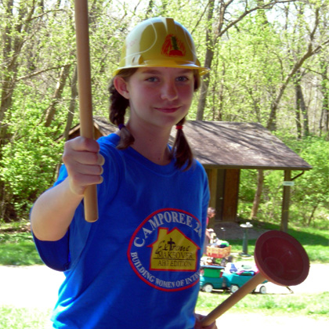
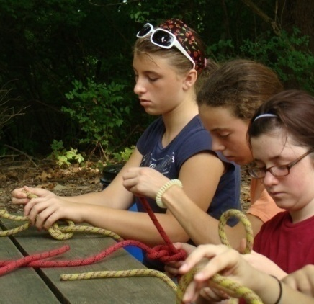
Life Skill Enhancement
Merit Badge Frontiers
Family Living
Science & Technology
Personal Well – Being
The Arts
Heritage
Outdoor Skills
Notes:
“AHG helps girls acquire skills that will assist them in all areas of their life through merit badge acquisition. These experiences range in topic and are found in AHG’s six frontiers of skill: Heritage, Family Living, Arts, Outdoor Skills, Personal Well-Being and Science and Technology. The merit badge program is age appropriate and multi-level allowing for girls of all ages to work together at a pace that is appropriate for them.
Leaders should plan ahead, considering girl input, and determine which badges the Troop/Unit will strive to earn during the program year. Leaders should remember that the Merit badge achievement is simply a small part of the overall AHG program. Earning too many badges can lead to girl burnout as well as the neglect of the other five program emphases. Typically a Troop earns 3-4 badges per year, but merit badge acquisition requires a careful balance.
Merit Badges can be earned as an individual and at a Troop level. On pg. 30 in the Unit Leader Handbook, a suggested list of merit badges that work best for a Troop setting as well as individual achievement is featured. The Troop Board should establish guidelines for managing individual merit badge achievement.”

Slide 19
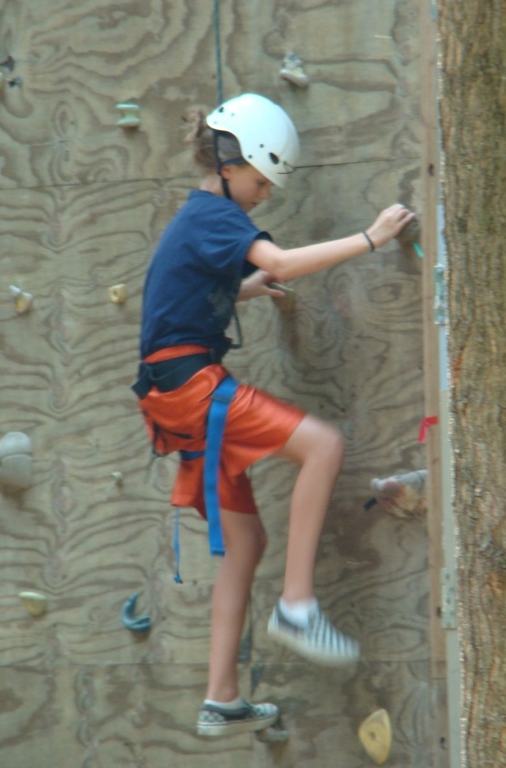
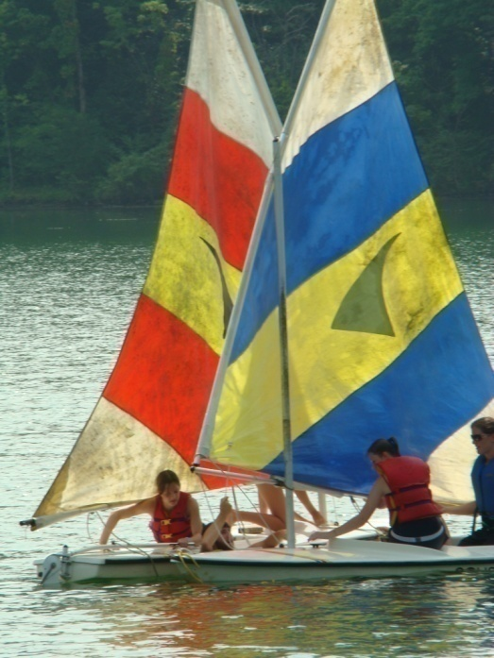
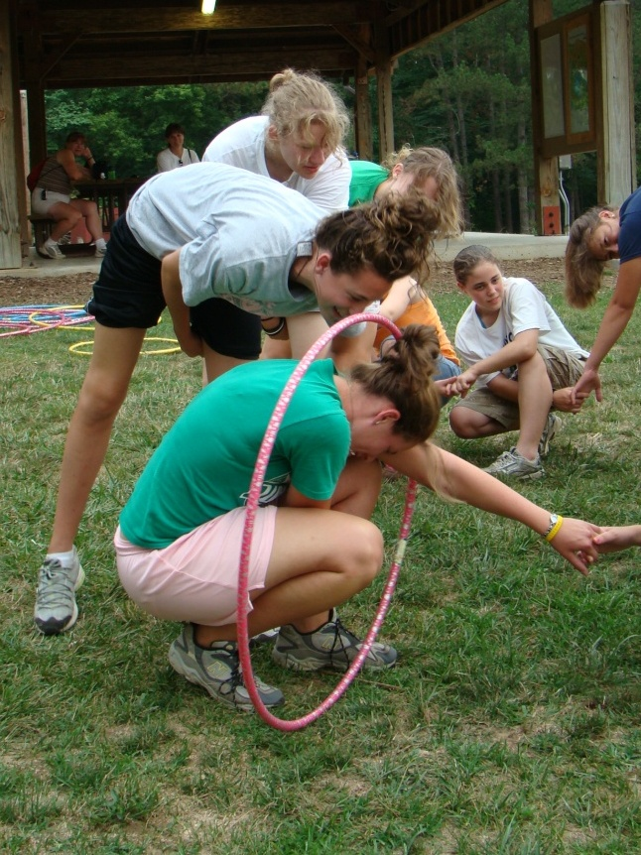
Developing Teamwork & Building Confidence
Notes:
“Working as a team is important to any Troop. Teamwork skills are enhanced at each meeting as girls work together to achieve common goals. The outdoor experiences intrinsic to the AHG program create an exceptional environment for girls to accept challenge, achieve goals and build confidence and self-reliance.
AHG’s progressive outdoor program provides girls with an opportunity to explore the outdoors in a manner that is often not available at home or school. Outdoor programming will assist girls in developing spiritually, physically and emotionally.
Successful AHG Troops include exciting outdoor opportunities. Troops are encouraged to plan at least one outdoor experience per year. It is crucial that girls have the opportunity to experience the wilderness. These experiences help to empower young girls, teaching them survival skills, and allow them to enjoy God’s beautiful creation!
Outdoor opportunities should be progressive in nature, helping to build anticipation, as well as meeting the development needs of girls. Outdoor experiences can range from a simple overnight trip to a high adventure multi-night activity. A Pioneer Unit can be introduced to the out of doors through a multi-troop resident camp, while a Patriot Unit may be ready for a multiple night ten camping canoe trip. These progressive outdoor opportunities are especially helpful in retaining older girls.
AHG has developed a model suggesting how a girl should progress through outdoor experiences. This model can be found in your Unit Leader Handbook on pg. 32 and 33. This progression chart is designed to be a guide to assist Leaders in planning outdoor activities for their Troops. Keep in mind, when planning these activities that AHG Health and Safety Guidelines should be consulted prior to planning an outdoor adventure and girls’ age abilities, experience, interests and maturity should always be taken into consideration.”

Slide 20
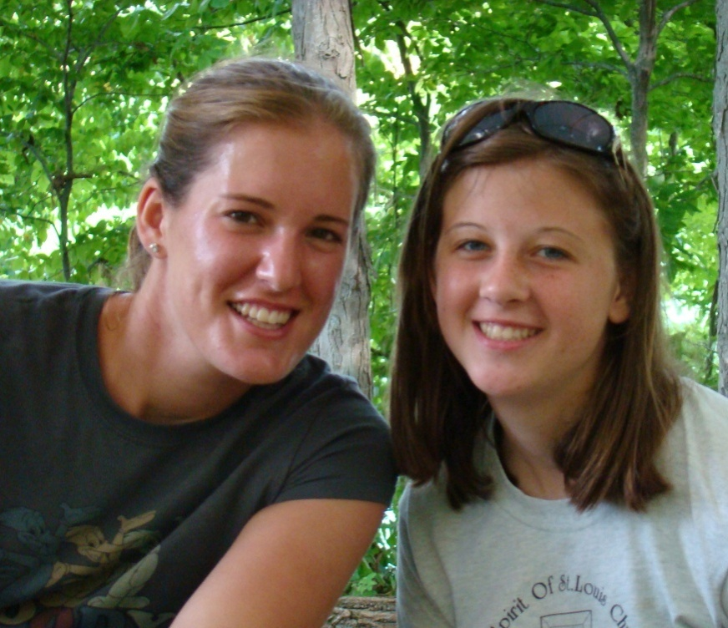
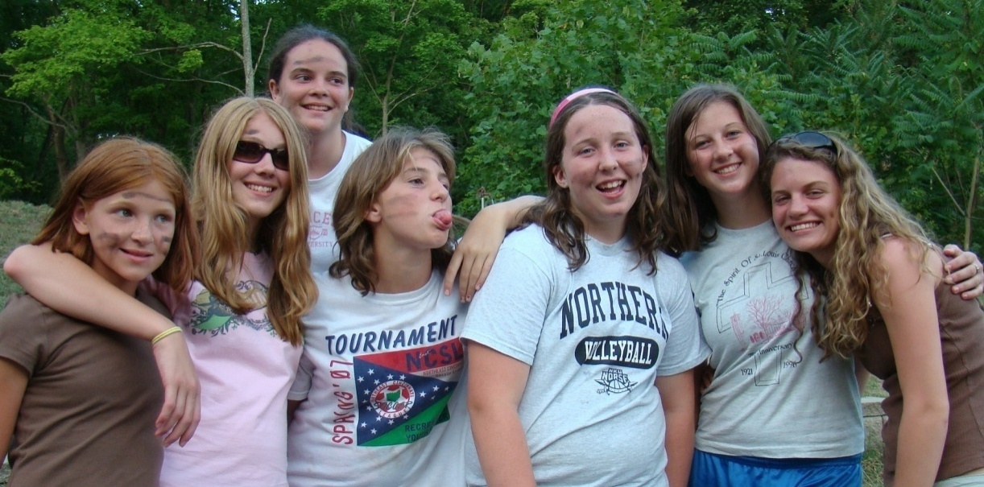
Social Development
Notes:
“Girls love to have fun and rate time with their friends as the main reason they love AHG. The secure setting of an all girl environment supervised by trained, adult mentors allows for life-long friendships to develop and grow. Providing social activities allows the Troop to form a community for its members and their families. Social Development can be fostered through a number of avenues, including Special Events, Troop community as well as outward focus to the community at large.
AHG provides a progression guide to assist Leaders in planning social activities for their Troops. This chart can be found on pg. 33 of the Unit Leader Handbook.”

Slide 21
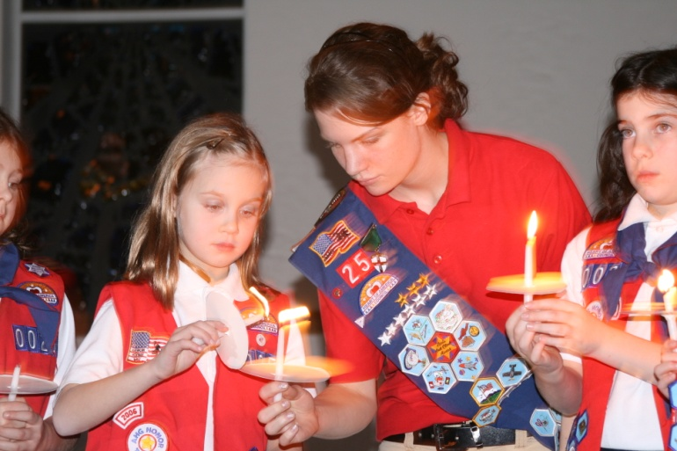
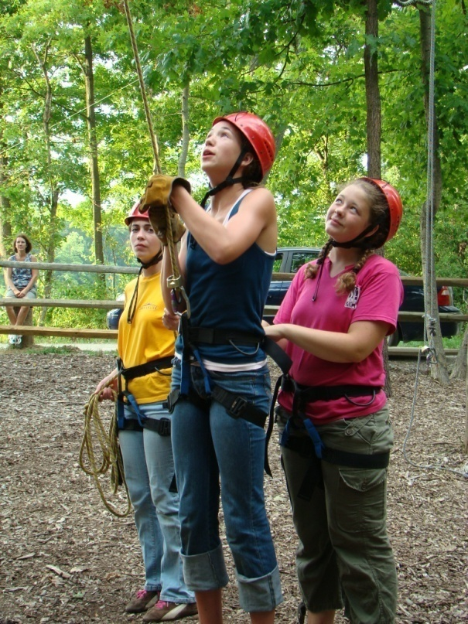
Girl Leadership
Notes:
“Women have a unique role in society. They are the great “influencers” and provide leadership at a number of levels throughout their lives. AHG strives to offer leadership opportunities at every level of the AHG program. AHG’s multi-level structure creates a unique environment ripe for girl leadership mentoring; older girls teaching younger girls. Through many successful experiences, leadership becomes a lifestyle to AHG members.”

Slide 22
Levels of Leadership
Level 1: I do, You watch – observed leadership
Level 2: I do, You do – shared leadership
Level 3: You do, I watch – trained leadership
Level 4: You do, I go do something else –
owned leadership
Level 5: You do and develop someone else –
multiplied leadership
Notes:
“Developing leaders takes time and even planning. Look at the following levels of leadership and begin thinking how your Troop Leadership can begin to mentor girls through these levels. Remember, not all girls will end up a level 4 or 5 leader – we are all different. Any leadership growth, regardless of how small it may seem, is a success.
We encourage Troop leadership from multiple age levels to work together to create leadership opportunities for girls. A sample progression chart for girl leadership can be found on pg. 35 of the Unit Leader Handbook. This list is meant as a guide to assist Leaders in helping girls choose leadership roles within the Troop.”
Trainer Note: Highlight a few sample Pioneer &/or Patriot Leadership roles from pg. 35. (depending on the levels you are training)

Slide 23
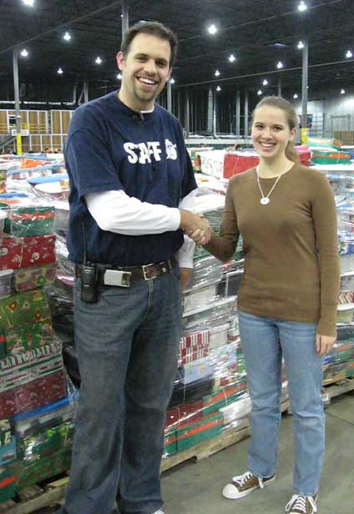
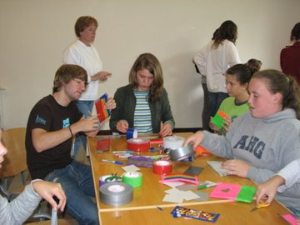
Character Development
Notes:
The AHG Oath and Creed provide the cornerstone of values that personify the AHG experience. Girls use these attributes as a “litmus” test to their success in fulfilling the mission of the American Heritage Girls, becoming women of integrity. In addition AHG’s strong service program encourages girls to put “legs on their faith” and put their values into action. AHG girls have an outward focus toward others’ needs rather than always seeking benefit to self. AHG offers experiences and opportunities for girls to have the right tools to make sound, moral decisions today and in the future.

Slide 24

Community Service
Tenderfoot 5 hours of service blue star
Explorer 10 hours of service red star
Pioneer 15 hours of service white star
Patriot 20 hours of service yellow star
Notes:
“Service is a practical way to show God’s love to those around us. Service projects enable girls to learn about the people in their community, their needs and what they can do to help meet those needs. Heritage Girls United Giving Service (HUGS) is American Heritage Girls’ service arm. HUGS projects may be completed at the Troop level, neighborhood level, in conjunction with other service organizations or the Troop’s Charter Organization. Each Troop must complete at least three service projects each year and report them on the HUGS Program Report. Troops can then purchase the official HUGS patch. Each year the Troop fulfills the HUGS obligation, it is eligible for a year-rocker patch that can be placed around the perimeter of the HUGS patch.
Girls also earn service stars based on their level and number of hours served. A girl’s unused service hours for service star recognition may be carried over to the next year.“

Slide 25
Planning A Service Activity
Consider:
    Community needs
    Troop Talents
    Matching Needs with Talents
    Community Contacts
    Creating A Plan
    Keeping Safety In Mind
    Public Relations
    Following Through with Commitment
    Keeping Accurate Records
Notes:
“There are several directions to take when fulfilling your Service Project Requirements. Just like all other AHG program elements, your service projects should be progressive. As girls mature, they should be taking on an active role in choosing, planning and implementing the projects and their service projects should challenge them to stretch and grow. Planning ideas can be found on pg. 38 – 40 in the Unit Leader Handbook.
The following questions can help in planning the right project for the girls:
What are your community needs? Where do the girls see problems that they would like to solve?
What are your Troop’s talents?
How can you match a need with a talent to create a service project idea?
What are some community contacts?
What is your plan for safety and success?
What are the safety concerns that need to be addressed so that you can have fun at your activity?
Where can you submit a press release promoting your activity?
How can you be sure to follow through on your commitments?
Did you keep accurate records?
AHG provides a Character Development progression chart along with service project ideas on pg. 38 – 40 in the Unit Leader Handbook. These progression charts are guides in assisting leaders in developing age-appropriate activities for girls.”

Slide 26
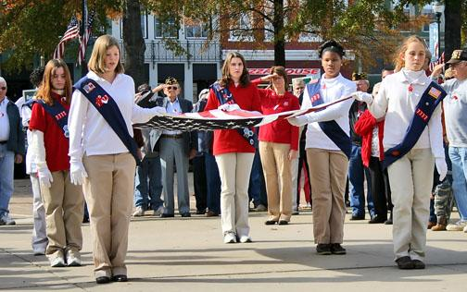
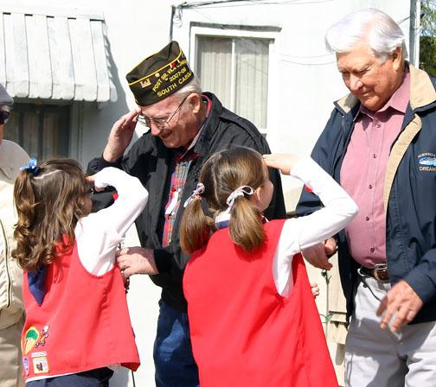
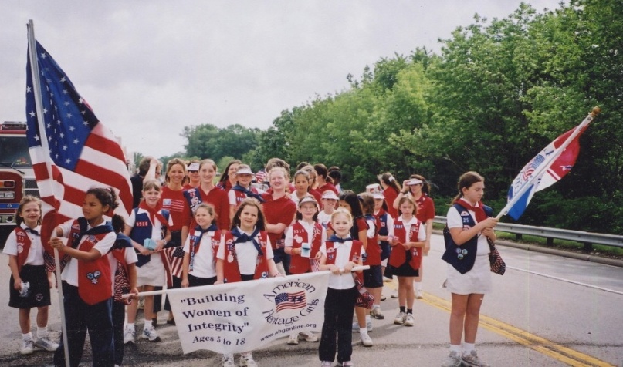
Citizenship
Notes:
“AHG seeks to teach girls what it means to be an active citizen of the United States. Whether learning about the democratic process or honoring those who have served our country with courage and honor, the AHG program works to establish a sense of patriotism in its members. Through a variety of citizenship programs girls can begin to understand the great blessing that it is to live in the United States.”
Trainer Note: Have everyone turn to pg. 36 of the Unit Leader Handbook and share a few suggested ways girls can develop their patriotism.

Slide 27
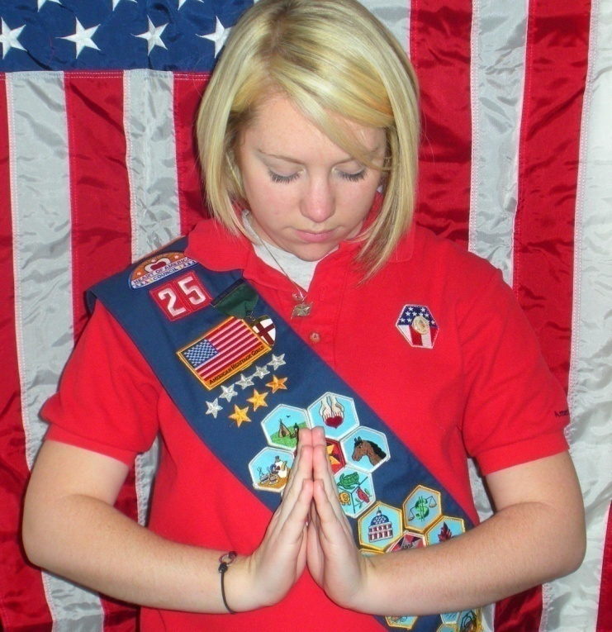
Spiritual Development
Notes:
“AHG encourages each girl to grow in her faith and relationship with God.
Each AHG Troop has a special Troop Shepherd who seeks to get to know each girl and pray for each girl. The Troop Shepherd, along with other Troop Leadership members are key to encouraging girls to grow their faith. Whether through Troop meeting prayer, Unit Bible studies, or modeling Christ-like behavior, Adult Volunteers can have an eternal impact on the lives of girls.
AHG provides a progression chart to aide Troop Leaders in providing age appropriate opportunities for girls to deepen their faith. This chart can be found on pg. 41 of the Unit Leader Handbook.”
Trainer Note: have everyone turn to pg. 41 of the Unit Leader Handbook and share a few types of projects that are suitable for Pioneer and/or Patriots (depending on who you are training)

Slide 28
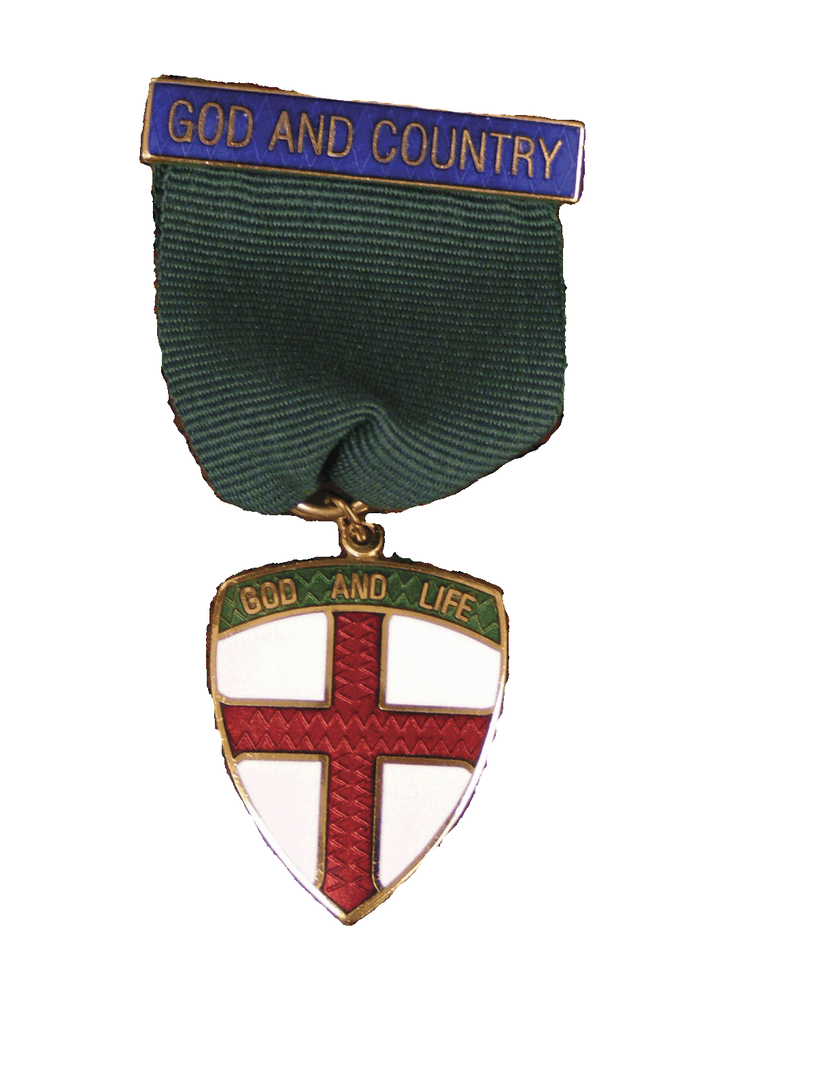

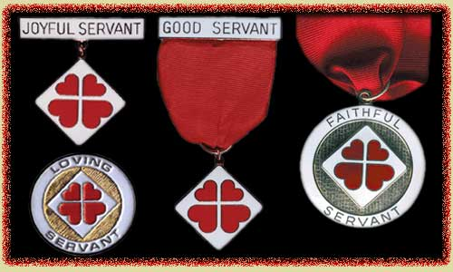
Religious Medals Programs
National Federation for
Catholic Youth Ministry
P.R.A.Y.
MCCS
Notes:
“One way to encourage Spiritual Development is through religious recognitions programs. AHG is honored to partner with the Program of Religious Activity with Youth (PRAY program for Protestant girls), The National Federation for Catholic Youth Ministry (NFCYM) medal program for Catholic girls and Members of Churches of Christ For Scouting (MCCS). PRAY workbooks are available at all levels, through the National AHG Attic,the Catholic workbooks are available through the NFCYM and MCCS workbooks are available through MCCS. Religious recognitions are at all levels of AHG but are integral to the earning of AHG’s highest award, the Stars & Stripes Award. Religious medal programs can be achieved as a unit or individually and are progressive in nature.”

Slide 29
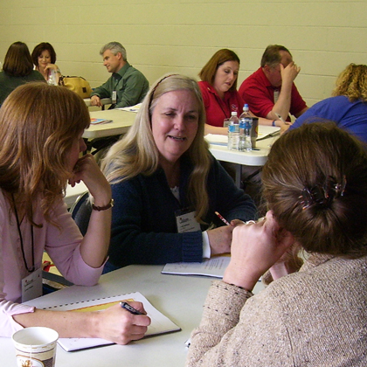
Group Activity
Notes:
Trainer Note: Review Breakout Activity Guide for additional information to facilitate a group activity)
Group Setting – Divide trainees into small groups have them brainstorm how they could incorporate as many program emphases as possible into a one day family event. Have groups consider the age/ability of their Unit when creating this activity.
Utilize a local location (such as a park, YMCA, Charter Partner, etc.)
Pick a theme for your day, making sure that all activities tie into this theme. (Themes can be a merit badge, service project, or simply a “fun” theme.)
Make an outline of what will occur throughout the day, indicating what program emphases are addressed with each activity.
If time permits, report your results with the group.

Slide 30
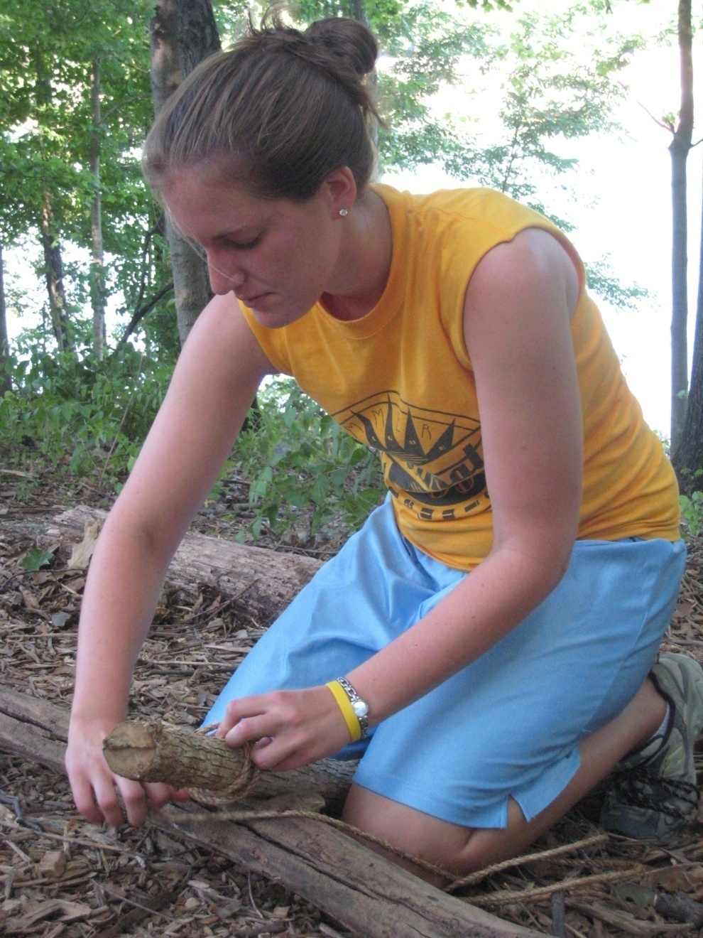
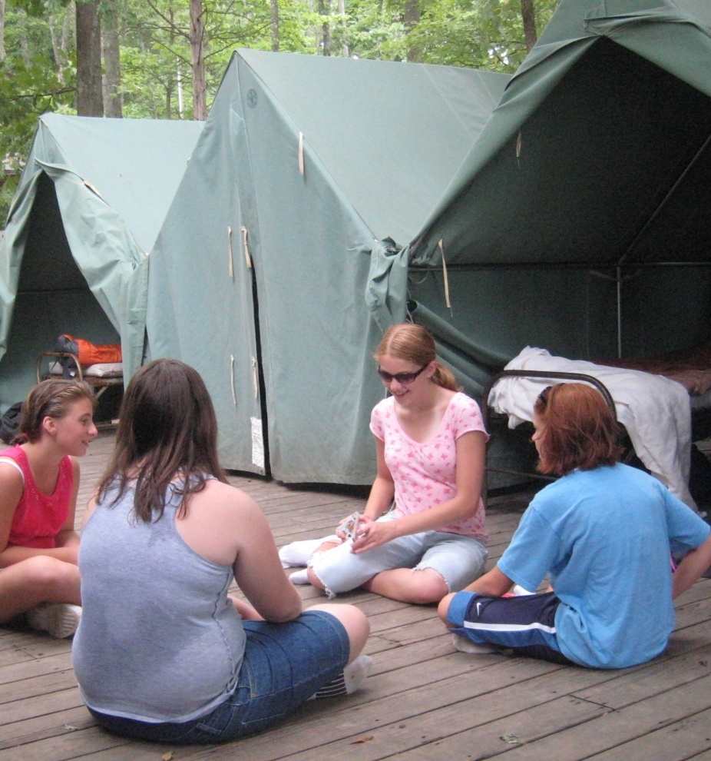
Learning Styles
Notes:
“Learning styles are a consideration that impacts not only Troop programming, but Troop dynamics in general. Just as girls and adults have differing personalities, they also have different ways of learning. Understanding how each girl and Leader learns, will aid in the planning and implementation of a program and most effectively accomplish the desired outcome.”
Trainer Note: For additional information on identifying and working with different learning styles, please refer to the Unit Leader Handbook CD.

Slide 31
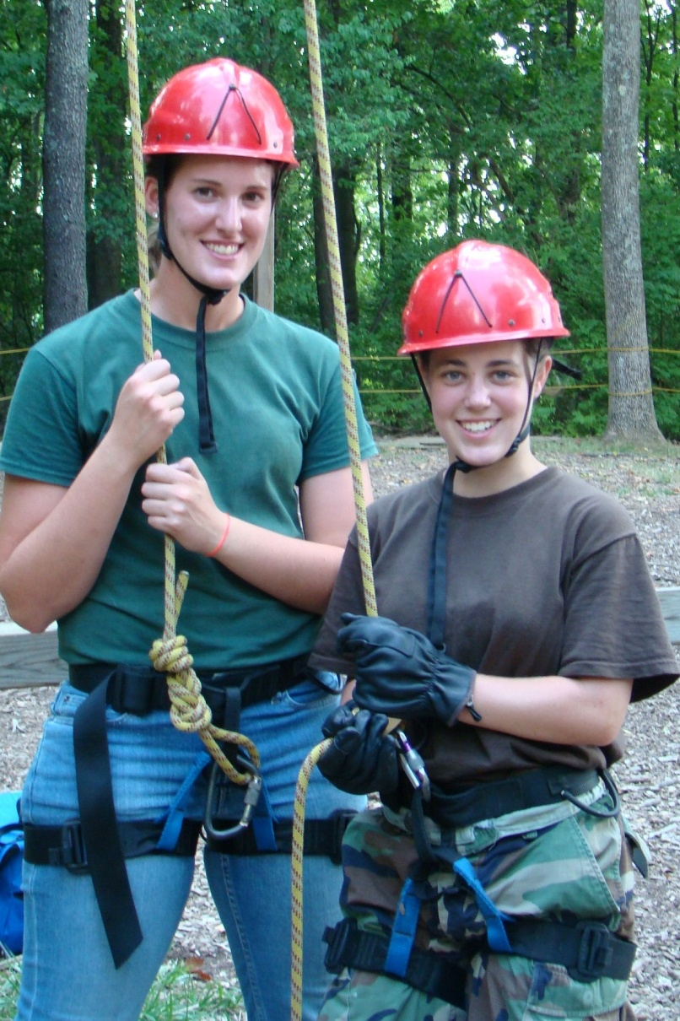
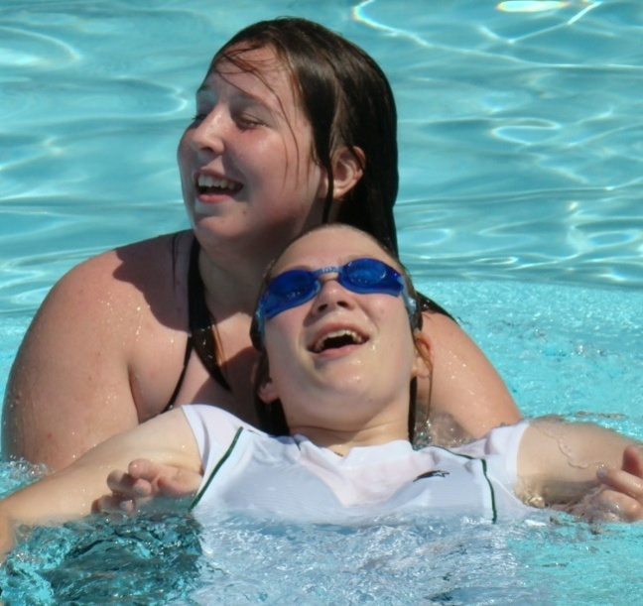
Working with Girls of varying abilities
Notes:
“It is crucial not only in fulfilling the mission of American Heritage Girls, but also in fulfilling the Great Commission, that AHG create an inclusive program, in which girls of all abilities can actively participate. AHG seeks to create an environment in which girls of all abilities can grow closer to the Lord while becoming women of integrity.
Girls’ needs vary based on a number of factors, including age, learning styles, emotional functioning, mental functioning and physical functioning. AHG asks that Troop Leadership work to create an environment in which all girls can feel welcome, grow and experience a level of independence. You are encouraged to work closely with parents to make the most of each girl’s AHG experience.
As you invite girls with special needs into your Troop, AHG has a number of resources available to assist you in this process. Beginning in 2009, AHG will be offering a leadership training experience focusing on working with girls with special needs. “

Slide 32
Managing Behavior
Set The Tone
Honor The Girls
Treat with Respect
Encourage, Encourage, Encourage
Be Sensitive
Be a positive role model
Have a blast!
Notes:
“A positive Troop/Unit environment is the first step in managing girls’ behavior. In a positive environment, girls know the expectations of what to do versus what not to do. The standards of behavior should be set within the realms of the girls’ developmental range, be achievable and rewarded. Remember that mistakes are an important step to learning and are to be expected of youth. A Leader’s reactions to girls’ mistakes are what will determine a positive learning experience or a negative, demeaning experience. Tips to creating a positive troop/unit environment include:
Honor the Girls – Listen to what they say. Get to know them. Know their dreams, their fears, their talents and their dislikes. Ask regularly about them. Make them feel valued, unique and an essential part of the group.
Treat with Respect – Part of honoring a girl is respecting her value no matter what. Despite a failing or poor choice, remember she is a child of God and worthy of each member’s unconditional love. Create an atmosphere of respect amongst the girls, encouraging each girl to love one another despite differences and disagreements.
Encourage, Encourage, Encourage – It has been said for every 1 negative comment it take 10 positive comments to counteract its effect. Encouraging girls to excel, to take a risk, to have an “I can” attitude is all part of the amazing power that the Lord gives His children through the Holy Spirit. Encourage the girls to pray for God’s guidance and assistance constantly, particularly during times of trial. Stop at that moment and take time to pray with a girl in need.
Be Sensitive – Girls come from all different backgrounds and in all sizes and shapes. Know their sensitivities and fears and create an environment that will be loving and supportive.
Be a Positive Role Model – Shhh… they’re looking. Believe it or not, all eyes are on the Leadership Team. The girls will model the behavior good, or bad, that they see from their Leaders: if the girls see you gossiping about one another, complaining about the Staff, sharing negativity – they will do the same, imitating your actions. “Do unto others as you would have done unto you.” Live the AHG Statement of Faith, make it a continuous way of life for you.
Have a Blast! – No matter what you may have left at home, remember this is your time with the girls. Bring a fresh face and a new attitude. Paint the room with happiness. Make your AHG Unit fun, exciting and THE place to be!”

Slide 33
Forms of Troop Government
Tribal Ring
Town Meeting
Squad Method
Patrol System
Pathfinders Explorer Explorer PI/PA
Tenderfoot PI/PA PI/PA
Explorer
Notes:
“The manner in which a Troop is governed can lend itself well to progressive girl leadership. You may use as many systems as you need, depending on your type of Troop. Having the girls run their own meetings is the ultimate goal of the AHG program. Encourage each member from Pathfinder to Patriot to have an active role in the meeting. Give them ownership of their Troop! They won’t want to miss a meeting if they feel they have an important role to play. The formats shown are progressive in nature. As the Troop and girls mature, your system of governing will also change.”
Trainer Note: Review the example governance diagrams and the recommended levels. Additional information about each troop governance option is found on pg. 34 in the Unit Leader Handbook.

Slide 34
Patrol System
Girl Patrol Leader
Girl
Girl
Girl
Girl
Notes:
“The patrol system is used within the Squad structure. This system is commonly employed for a specific purpose or project. The patrol system is best when you have 4-6 girls in each patrol. Patrols can be named differently and are designed to carry out work and decision making in a streamlined fashion.
For example, if your Troop Is planning a dedication ceremony, patrols may be assigned for the following duties: decorations, set-up/clean-up, food preparation and planning, and program. Each patrol will have the responsibility, with adult leadership, of planning each aspect of their assigned duties. “
Trainer Note: Turn to pg. 35 of the Unit Leader Handbook to review the suggested progression chart for Girl Leadership roles by level.

Slide 35
Risk Management
Health and Safety Guidelines
Registration of members
Background checks for all adults in volunteer roles within the Troop
Notes:
“Risk Management is a necessary and important consideration when working with girls. It is most important that the Unit Leader be familiar with the AHG Health and Safety Guidelines found in the Unit Leader Handbook on pg. 93. The guidelines are also available on the Leader Resource area of the AHG website and on the Unit Leader Handbook CD. It is recommended that a Unit Leader review the Guidelines on an annual basis. Health and Safety guidelines are only one piece of Troop Risk Management. Other areas of risk management include:
Registration – AHG member registration is vital for both the individual Troop and the American Heritage Girls organization. Individuals are not considered members until their paperwork is received into the AHG, Inc. Office. This determination is crucial to reduce risk for both the local Troop and AHG, Inc. All Troop members must be registered prior to attending any Troop meeting or activity.
Background Checks - As a national Christ centered youth organization, American Heritage Girls has the obligation to exercise “due diligence” with regards to protecting its members, especially the girls. Careful screening of volunteers who work with children is an important risk management strategy. Failure to adequately screen volunteers may place children in dangerous situations. Checking the criminal history records of volunteers who work with children is one tool in shielding our children from harm. As part of the Leader/Adult Volunteer selection, it is imperative that all adults in volunteer roles with the Troop have a background check. This responsibility fall to the charter organization.
Additional information regarding background checks is available on pg. 48 of the Unit Leader Handbook and the AHG website at www.ahgonline.org/backgroundchecks”

Slide 36
Health & Safety
Two Deep Leadership
One First Aid/CPR Certified Leader per level
Health & Safety Lead for AHG Activities
  First Aid Kit
Pathfinder 6 girls / 1 Leader
Tenderfoot 6 girls / 1 Leader
Explorer 8 girls / 1 Leader
Pioneer 10 girls / 1 Leader
Patriot 12 girls / 1 Leader
Notes:
“One of the key components in AHG Health and Safety Guidelines is to ensure that the Troop adheres to the adult/girl ratio and ALWAYS maintains two deep leadership, in accordance with ratios.
Two deep leadership is defined as two registered adults for each activity.
Trainer Note: Additional information can be found on pg. 47 Unit Leader Handbook, Pg. 38 Coordinator Handbook & Health & Safety Guidelines
Girl/Leader Ratios
Pathfinder 6 girls per 1 registered Leader
Tenderfoot 6 girls per 1 registered Leader
Explorer 8 girls per 1 registered Leader
Pioneer 10 girls per 1 registered Leader
Patriot 12 girls per 1 registered Leader
Each AHG Troop must have one CPR/First Aid certified Unit Leader per level, all activities must have a Health and Safety Lead and a first aid kit must be available at all meetings and troop activities. For more specific information, please see pg. 46 – 48 in the Unit Leader Handbook. “

Slide 37
Forms Overview
Troop Transport Form
Girl & Adult Health & Medical Forms
Parent Permission Forms
Troop Trip/High Adventure Notification Form
Notes:
“There are many forms that are needed for activities of the Troop. Unit Leaders should be familiar with the following forms based on the activities planned:
Troop Transport Form – this form is required for all adults planning on providing transportation for an activity or event. Parents and Volunteers who do not have a Troop Transport Form on file with the Troop may not provide transportation for anyone other than their own daughter(s).
Girl & Adult Health & Medical Forms – Each Unit Leader should have a set of Girl & Adult Medical forms for all girl and adult volunteers participating in Troop/Unit activities. Unit Leaders should review these forms when planning activities to identify any medical conditions, food allergies etc. of a girl/adult member.
Parent/Guardian Permission Forms – All Troop activities outside of regular Troop meetings must have a Parent/Guardian Permission Form. This form provides vital information to the Unit Leader at the time of the activity and helps in the planning of an activity. Parents accompanying and transporting their own daughter only to an activity do not need to complete a Parent Permission Slip. “
Troop Trip/High Adventure Notification Form – This forms needs to be completed for ALL camping trips and any activity that is 75 miles or more from the Charter Organization. If a High Adventure Activity is planned for girls, this portion of the form must also be completed and submitted to the AHG/Council office. This form also requires Troop Coordinator and Charter Representative signature, so pre-planning is necessary to receive approval from your Support Services Coordinator.
High Adventure Medical Form – is required for all activities that involve a High Adventure as defined in the AHG Health & Safety Guidelines. This form requires a physicians’ signature. It is suggested that the form be given to all Pioneer & Patriot level girls well in advance to enable this required signature. This form can be kept on file with the Troop and is good for one year.
Most up to date forms can be found on the leader resource area of AHG Website.”

Slide 38
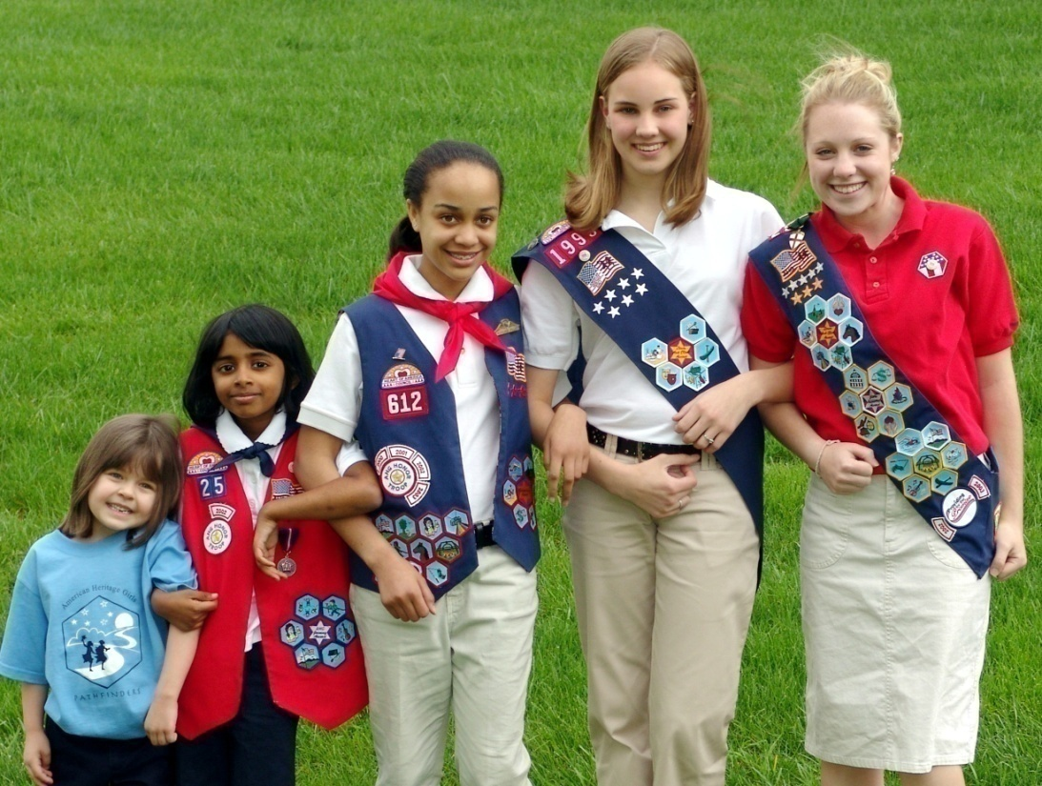
AHG Ministry to Girls
Notes:
“Now that you have learned the elements of the AHG program, let’s talk about how to take what you have learned and create a Troop meeting that is fun and exciting for the girls.”
Trainer Note: AHG Ministry to Girls section begins on page. 61 of the Unit Leader Handbook.

Slide 39
Planning A Troop Meeting
Meetings should include:
Set Up Time
Opening prayer and flag ceremony
AHG Oath, AHG Creed and Song
Troop business and announcement time
Activity, Badge work or Service project
Clean up time
Closing Activity
Notes:
“Each regular Troop meeting should utilize the elements shown in the slide to help with accomplishing goals and provide consistency to the program. The Troop Meeting Planning Sheet can assist you with using the program elements to accomplish your Unit plans. The Troop Planning Sheet along with four sample Troop meetings can be found on the Unit Leader Resource CD. Additional information and resources for activities to enhance your program can be found in the quarterly Leader Resource Guide and the Leader Resource area of the AHG website. Leaders are encouraged to allow girls to assist with planning their meetings.”

Slide 40
Troop Meeting Tips
Snack Time
Craft & First Aid Supplies
Use a Kaper System
Kaper | Duties | 1st Meeting | 2nd Meeting | 3rd Meeting | 4th Meeting
Set-Up | Setting up table and chairs | Susie | Mary | Amy | Julie
Flag Ceremony | Carries US Flag | Mary | Amy | Julie | Susie
Leader Helper | Helps distribute supplies | Amy | Julie | Susie | Mary
Clean Up | Puts tables & chairs back | Julie | Susie | Mary | Amy
Notes:
“Here are a few tips from many of AHG’s most successful Troops.
Snack Time – provide during pre-opening to save time. This is ideal for troops that meet after school.
Craft & First Aid Supplies – Many new Troops do not have initial money to purchase craft or first aid supplies when starting out. One idea to get supplies is to ask each girl to bring a supply box that includes scissors, markers, pencils, etc.) Or you may want to have a “Supply Shower” where girls can bring pre-selected craft or first aid supply to one of the meetings.
Use a Kaper Chart – A kaper, simply put, is a job or chore that must be done. This generally involves a “kaper chart” which indicates all of the jobs available and who is responsible for each one. This may be done with individual girls or if your Unit is large, break into patrols to accomplish many tasks. A kaper chart can be created by using poster board, paper plate or other resources. A kaper chart can be used for Troop meetings, campouts, or other activities. This sample shows how to set up “kapers” for a regular Troop meeting.”

Slide 41
Group Activity
Notes:
Group Activity – Divide trainees into small groups and have them plan a Troop meeting. You may wish to photo copy the Troop Planning Activity Sheet for each leader to use during this time. Allow the leaders approximately 20 to 30 minutes to plan a Troop meeting and come back together as a group to share their ideas. This is an excellent way to gain new ideas and to see if all Leaders have grasped the concept of troop meeting planning.

Slide 42
Troop/Unit Health Indicators
Notes:
“On pg. 63 in the Unit Leader Handbook, you will find a chart showing Troop/Unit Health Indicators that can assist a Leader to gauge how well the Troop/Unit is functioning. If many of the Troop indicators are healthy, make sure to commend your fellow Troop Leadership. If the indicators are poor, create positive change. Addressing warning signs early will help you avoid girl and volunteer loss, Coordinator burn out and even Troop closure.
Trainer Note: Review the list on pg. 63
“These indicators were gleaned from successful and struggling Troops – real life examples.”

Slide 43
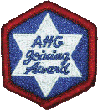
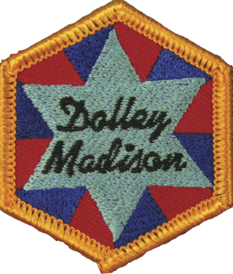
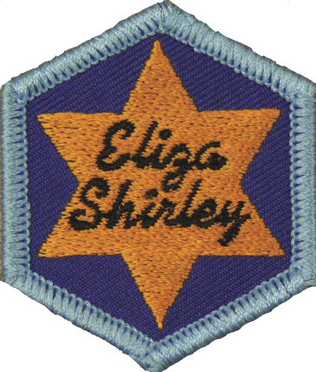
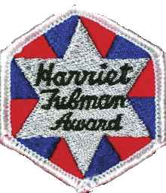

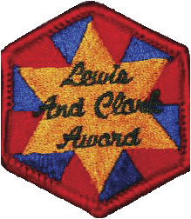
Level Awards
Joining Award
Level Awards
Level Award Planning
Notes:
“The Joining Award is the first Award an American Heritage Girl Tenderfoot and up earn. The Joining Award can be earned within a Troop/Unit or independently. If a girl joins, and the majority of her Troop has already earned their Joining Awards, her Unit Leader along with the Parent can assist the girl in completing the requirements within one month of joining. Requirements for the Joining Award are located in the Girl Handbook on page 24. This award should be earned within the first quarter of membership and requires candidates to wear the official AHG uniform. A Joining Award Resource Packet and sample ceremonies can be found on the Leader Resource Areas of the AHG website.
Level Awards
American Heritage Girls offers each girl member the opportunity to earn her Level Award. These awards reflect the overall AHG program and are highly recommended for all girls. Not only do these awards foster incredible learning, but they also assist with girl retention. However, these level awards are not required to continue in the AHG program. In some cases, girl members and their families may choose not to work towards their level award due to special circumstances. A girl member will receive the optimal experience by participating in AHG’s advancement program.
The steps toward the Level Awards include merit badge work, leadership opportunities, special event participation and community service hours. Level Awards are completed and recognized in the last year of a girls’ level. Specific requirements for the Level Award can be found in the Girl Handbook. Additional Level Award Tracking Sheets are available on the Leader Resource Area of the AHG website.
It is highly recommended that a Troop develop a two-three year plan to assist their members in earning their Level Awards. To assist Leaders in developing a plan, AHG has developed 1,2, and 3 year level award plans for each level award, depending on the year a girl becomes a member. These plans can be found on pg. 65 of the Unit Leader Handbook and are available on the Unit Leader Resource CD.”

Slide 44
Board of Review
Purpose:
All requirements have been met
Understanding the quality of the experience
Encourage progression through the AHG program
Practice poise & interview skills
Notes:
“Each girl earning their Level Award (Tenderfoot – Patriot) must participate in a Board of Review, organized at the Troop Level, at the end of the level year (i.e. Tenderfoot – 3rd grade, Explorer – 6th grade, Pioneer – 8th grade, Patriot 10th/11th grade). Pathfinders do not need to participate in a Board of Review.
The purpose of a Board of Review is to make sure that each American Heritage Girls has completed all requirements for her Level Award, understand the quality of the experience the girls is having in her unit and to encourage the American Heritage Girl to progress further.
The Board of Review provides “quality control” for advancement within the Unit, allows a girl to practice poise as well as develop and practice skills needed in an interview situation.
The Board of Review consists of three – six adult volunteers from the Troop or Charter Organization, depending on the Level being reviewed. Additional information about establishing a Board of Review along with sample questions can be found on pg. 70 and 73 of the Unit Leader Handbook.”

Slide 45
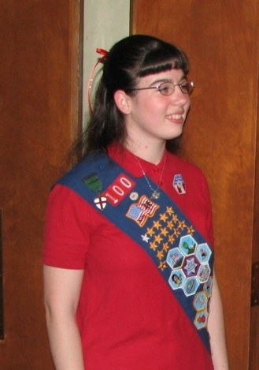
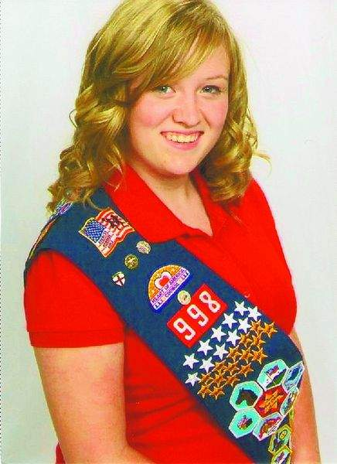

Stars & Stripes Award
AHG’s Highest Honor
Notes:
“The Stars & Stripes Award is the highest recognition an American Heritage Girl can earn. This award is a multi-faceted award that honors girls who epitomize the AHG Oath and Creed. The steps toward the Stars & Stripes include merit badge work, service, religious recognition award and leadership opportunities. Additional information about this award can be found in the Unit Leader Handbook on pg. 69, Leader Resource Area of the AHG website and the AHG Girl Website.”

Slide 46
Advancement Recordkeeping
Girl records should include:
Merit Badge Achievement Record
Service Hour Tally Sheet (annual)
Girl Level Award Tracking Sheet
Joining Award Tracking Sheet
Attendance
Notes:
“It is very important that each Troop keep accurate records for merit badges, service hours, Joining Awards, Level Awards and other recognitions. These achievements should be recorded in each girl’s AHG Girl Handbook and in a Troop recordkeeping system. Record keeping can be accomplished by a Unit Leader or an Advancement Manager who is attentive to detail and understands the program elements. These records must be kept up to date and will be needed at the time of a girl’s Board of Review for her level award and for insignia ordering. Check with your Troop Coordinator to see how insignia ordering is handled so that records can be shared at time of merchandise ordering.
Forms and additional resources can be found on on the Unit Leader Resource CD and also on the Leader Resource Area of the AHG Website for download.
Information regarding AHG Troopmaster software (troop recordkeeping software) is available on the Leader Resource Area of the AHG Website as well.”

Slide 47
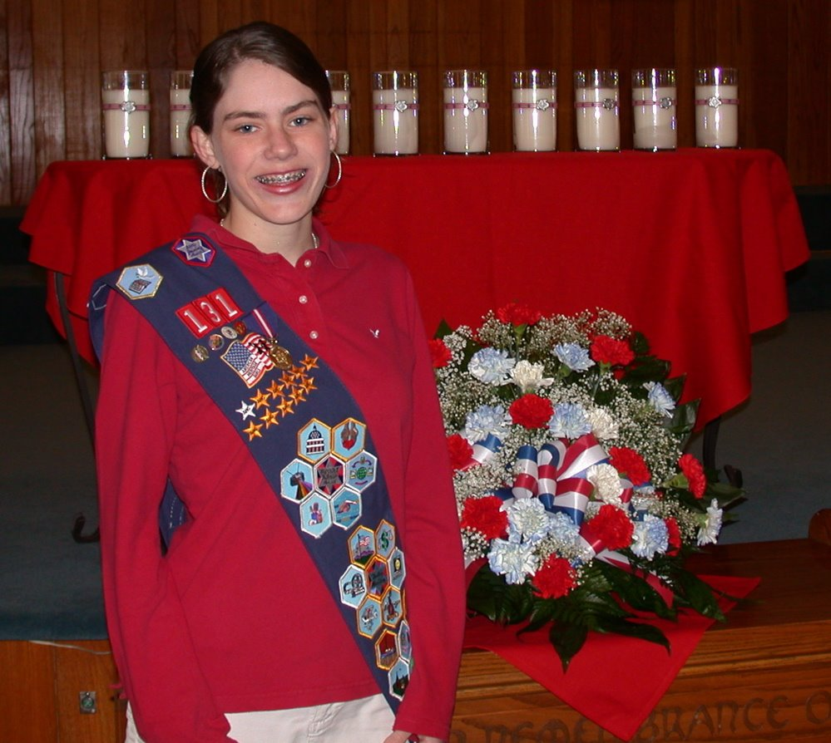
Ceremonies
Notes:
Some of the most memorable activities a Troop provides are ceremonies. There are many different types of ceremonies that a Troop may offer. A Flag ceremony is probably the most common and consists of a simple ceremony that may be planned as part of the opening and/or closing of a regular Troop meeting. Special ceremonies may also be planned where girls are recognized for achievements earned Merit Badges, Level Awards, Service Stars, Religious Recognitions and Troop Recognitions. A typical Troop will offer a Basic Flag Ceremony at all regular Troop meetings, a Joining Award Ceremony when girls are ready to receive their Joining Awards ; a Mid-Year Ceremony to recognize achievements from the Fall and an End of Year Court of Awards where the remaining Merit Badges, Service Stars, Level Awards and other achievements may be recognized. How a Troop plans and implements their ceremonies is usually decided by the Troop Ministry Team. Ceremony samples and a ceremony planning worksheet and additional tips for planning special ceremonies may be found on the Leader Resource Area of the AHG website and the Unit Leader Handbook CD.
On pg. 75 of the Unit Leader Handbook is a sample progression chart to guide Leaders in planning Ceremonies for the Troop. AHG encourages girl participation in helping plan and implement ceremonies. An additional progression chart on pg. 76 provides ceremonies activities girls may assist with by age level.”

Slide 48
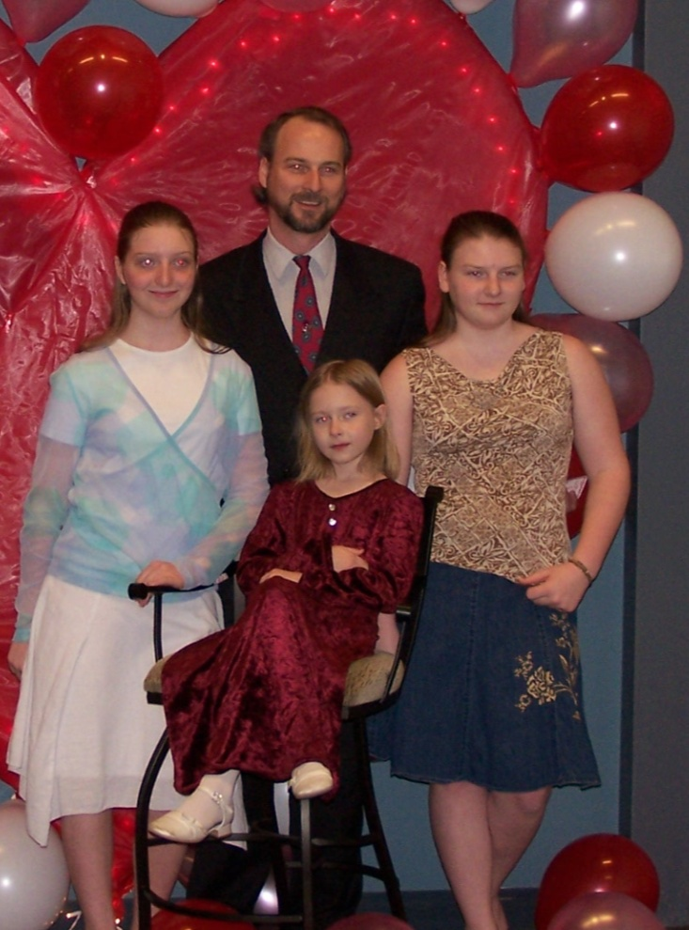
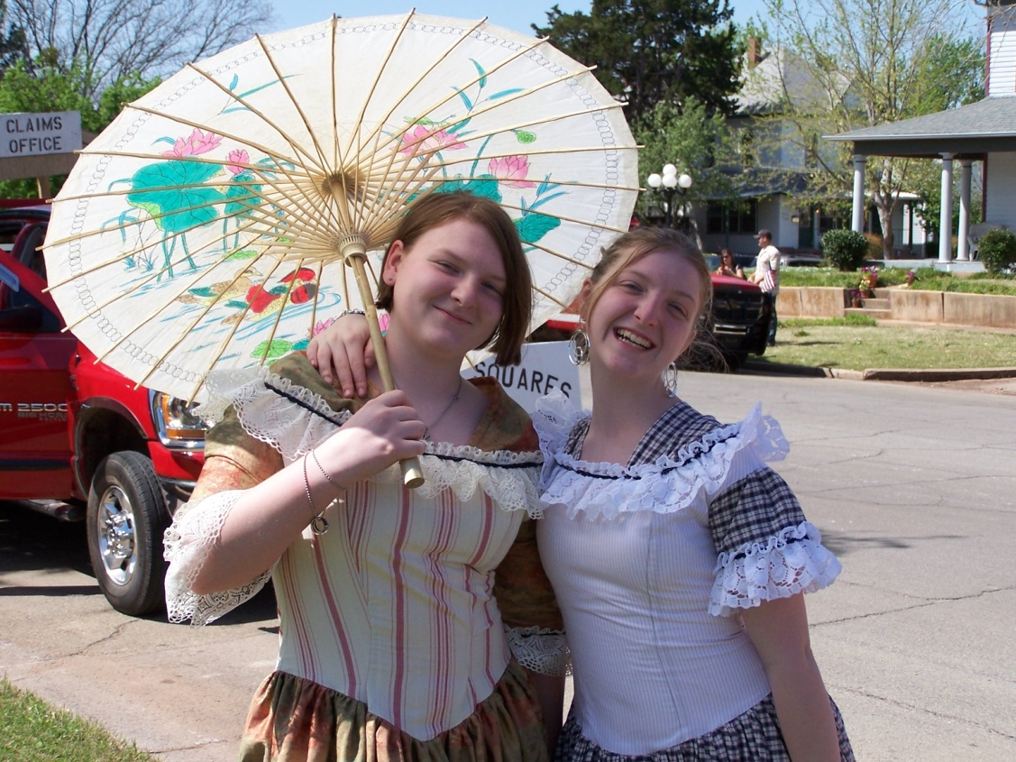
Troop Special Events
Notes:
“Troop Special Events are also an integral part of the AHG program. A special or “organizational” event can be defined as an activity that is social in nature that is planned outside of regular troop meetings. A Special Event Guide has been developed to assist all Troops with the creation, budgeting, implementation and evaluation of a special event. These events are held to create lifetime memories for the girls, while giving them a time of fun and fellowship outside of the “normal” troop meeting. Many times additional family members and friends are included in Troop Special events as well as a Troop’s Chartering Organization. Please refer to the Unit Leader Handbook CD for the available Special Event Guide.
If you are in a counciled Troop, please contact your Local Council for Special Event Guidelines.”

Slide 49
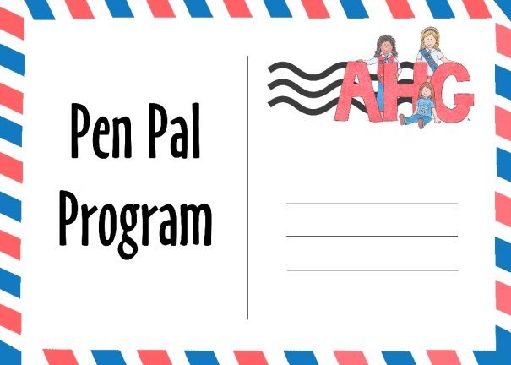



AHG Partnerships & Programs
Notes:
“AHG continues to develop national partnerships to enhance a Troop’s program offerings. Currently AHG has developed partnerships with Operation Christmas Child (Samaritan’s Purse), Compassion International (Pen Pal program), Precious Moments Clubs, among others. AHG also offers an annual AHG National Pen Pal program. Information about these program can be found on the Leader Resource Area of the AHG Website as well as the quarterly Leader Resource Guide. It is encouraged for Unit Leaders to incorporate these program into the offerings at the Troop level.”

Slide 50

AHG Girl Website
www.ahgonline.org/girls
Notes:
“AHG offers a Girl website to assist members and non-members with a variety of information and resources. Girls should be encouraged to visit the site and provide feedback as it is the desire of AHG to make this an interactive and growing experience.”

Slide 51
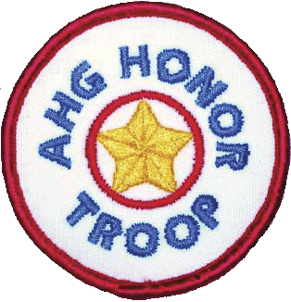

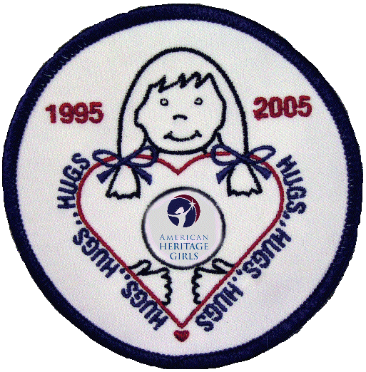

Troop Recognitions
Honor Troop
HUGS Patch Program
PFP Patches
Girl Activity Patches
Notes:
AHG provides several Troop recognition opportunities. When a Troop receives a recognition that is designated Troop recognition, it simply means that the entire Troop earns the recognition, regardless if a girl participates in each of the activities or not. Presently there are three recognitions that are regarded as Troop Recognitions. Troop Recognitions include AHG Honor Troop, HUGS Service, and Annual Family Stewardship Campaign available through the AHG attic. Troops may also purchase activity patches from patch companies that represent field trips or special activities of the Troop.”

Slide 52
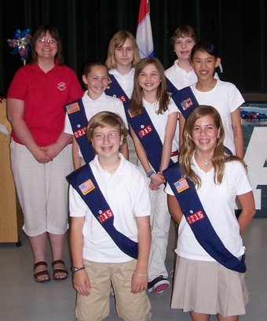
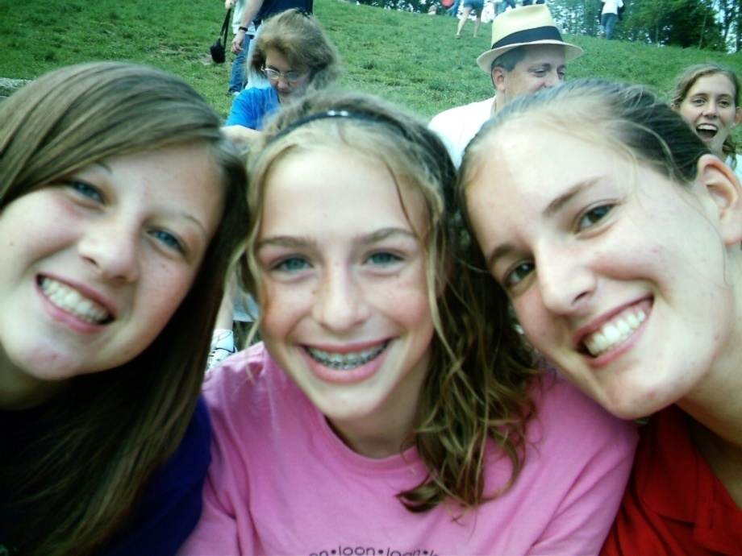
Nurturing the AHG Troop
Notes:
“As your Troop matures and grows, the Troop leadership and families will become more comfortable with the program elements allowing Troop membership to grow and be nurtured by the adult volunteers. The Leadership Team as well as the Troop families will become more like a community thus multiplying its numbers and its impact.”

Slide 53

Spiritual Development of Unit Leadership
Notes:
“It is often said that AHG is not just a ministry for girls; it is also a ministry for women. Consistent, intentional spiritual growth will make your AHG journey a true blessing to yourself, those you encounter and to our Heavenly Father. It will make you a more impactful ministry partner, allowing God’s power to be unleashed as you minister to AHG’s members and fellow volunteers.
Troop Boards and their Shepherd often engage in Troop Bible Studies or book clubs. They encourage one another through Board praise and prayer reports. They seek devotions on the internet or through small guides. They care for one another by inquiring about each other’s wellbeing. The Troop Board and the entire Troop Leadership Team set the tone of care and compassion for the girl members too. If the leadership truly cares for one another, so will the girls.

Slide 54
Succession Planning
“If you fail to develop a strategy to replace yourself, you will
  Force talented individuals to remain in the wings.
  Cause potential leaders to exit the organization.
  Stifle needed insight from valuable team members.
  Hinder your ability to recruit volunteers.
  Limit the growth of your programs and ministries.”
Andy Stanley
“Seven Practices of Effective Ministry”
Notes:
At some point in time, you may decide that it is time to change your leadership position, as a Unit Leader or other key adult volunteer position. In order to continue the dedication and effective leadership style you developed, it is most important to pass the baton to someone capable of continuing the vision that was started.
Carefully selecting adult volunteers based on gifts and talents is the most effective way to have volunteers that serve passionately allowing them to provide meaningful contributions to the Troop.
Resources to help in selection include:
www.giftest.org
www.uniquelyyou.com
Charter organization spiritual gift assessment classes

Slide 55
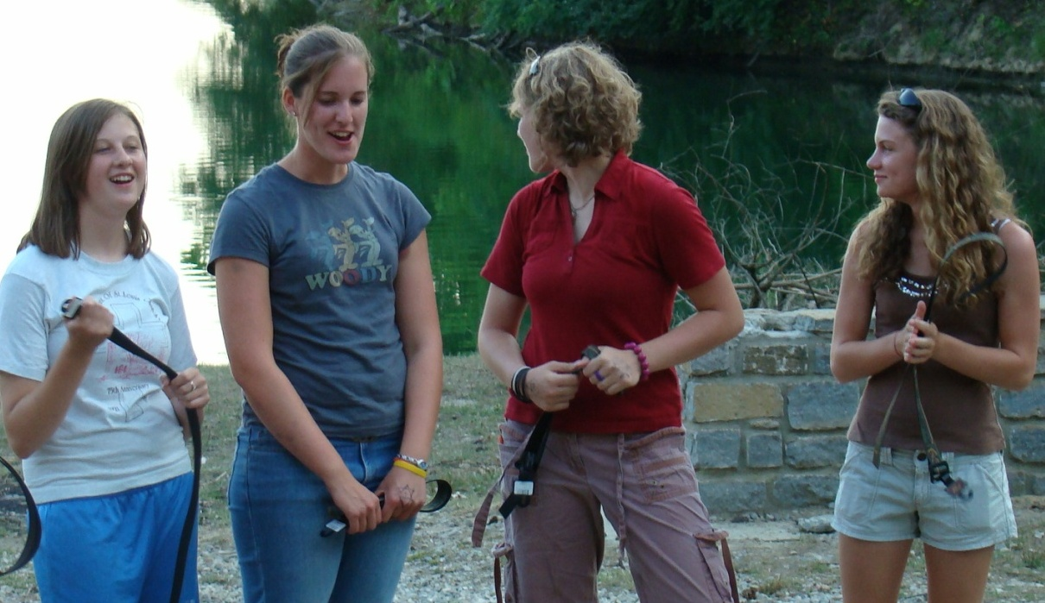
Recruiting Adults/Girls
Recruiting is an “Ongoing Process”
Develop an annual recruitment plan
Notes:
“Girl Recruitment -It is most important that as a Troop grows, that the Troop Ministry Team develop an annual recruitment plan. This plan should include various ways to recruit new girls to the program. One of the most effective ways to recruit is word of mouth, or a personal invite. Many successful Troops have recruited many girls by providing a Bring a Friend activity as part of a regular Troop meeting or a special event such as a bowling activity.
Trainer Note: Review resource tips on pg. 89 (Unit Leader ) and Coordinator (pg. 76). Ask audience for any good tips.

Slide 56
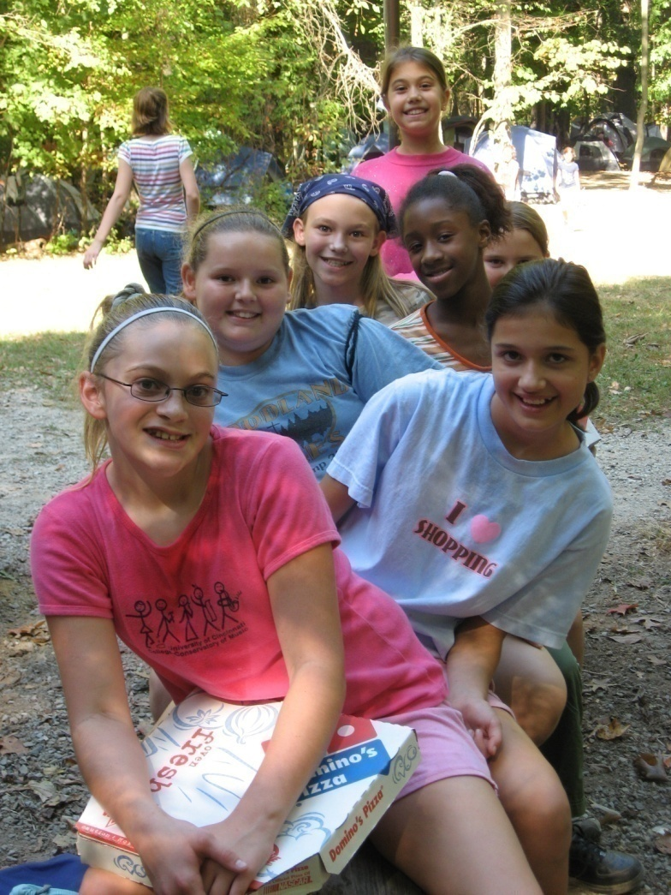

Girl Retention – What Keeps Girls in the Program?
Notes:
“Keeping girls active in the program is very important and should be a priority of the Troop Ministry Team. It is important that the Troop put a process in place for checking on girls that have missed meetings, are not coming frequently or have not returned at all. In most Troops, The Troop Shepherd will fulfill this important role, however, the Unit Leader should also be attentive to the girls in the unit. Suggested tips to keep your program “fresh” and keep girls “active” can be found in the Unit Leader Handbook on pg. 86.”
Trainer Note: select a few tips found on pg. 86 to highlight.

Slide 57
Group Activity
Notes:
Trainer Note: Review Breakout Activity Guide for additional information to facilitate a group activity.
Group Setting – Divide trainees into two patrols (more if large group). Have one group brainstorm ways to help with retention at their program level. The second group should brainstorm ways in which to make new girls feel welcome within the Unit.
Ask group to be specific with their ideas. Both groups should share their ideas with the training group for feedback.

Slide 58
Communication
Parents
Troop Board & Leadership Team
AHG Inc. /Council Office
Notes:
“Good communication between Unit Leaders and parents as well as the Troop Ministry team is essential for a successful Troop. A variety of communication methods can be used depending on the Troop’s membership and their life-styles. A plan should be developed by the Troop Board and utilized by the Troop Leadership. It is essential that a Unit Leader communicate the activities and information of squad activities to the parents as well as to the Troop Board. Check with your Troop Coordinator to determine the communication plan of the Troop so that families are not inundated with the same information from various sources.
AHG Inc. and the local Council Office (if applicable) communicates primarily via email to its membership. Vital program updates and information may be shared through this primary delivery system, thus it is important to read all emails coming from AHG/local council.”

Slide 59

Unit Leader Resources
Unit Leader Handbook
Leader Resource Guide
Leadership Connection
Leader protected website
Leader Forums
Notes:
“AHG provides many helpful resources to Leaders to assist them in implementing and planning Troop meetings. Each Leader should have a Unit Leader Handbook, receive from the Troop Coordinator the quarterly Leader Resource Guide and the quarterly Leadership Connection. These resources are also emailed to Unit Leaders on a quarterly basis. Along with these print resources, Leaders have access to the Leader resource area of the AHG website. Each member must register on the website to gain access to this valuable resource. Additional information can be found on www.ahgonline.org, select leader and follow the instructions on the Leader Homepage to receive a screen name and password.”

Slide 60
Q & A
Notes:
Trainer Note: Additional questions can be asked at this time.

Slide 61
Evaluation
Notes:
Trainer Note: Have your participants complete the Breakout Training Evaluation and submit to Troop Coordinator (group session) or AHG Support Services Coordinator (individual).
Thank your participants for attending. Close in prayer

